Slide 1
Kognitív idegtudomány
http://cogsci.bme.hu/~gkovacs/gyulakovacs/Teaching.html
Introduction to neurosciences for MSs.

Slide 2
Látás 5.
Ventral and Dorsal pathways

Slide 3
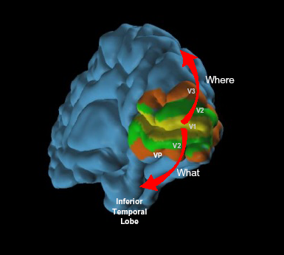
Do you really want to study vision?

Slide 4
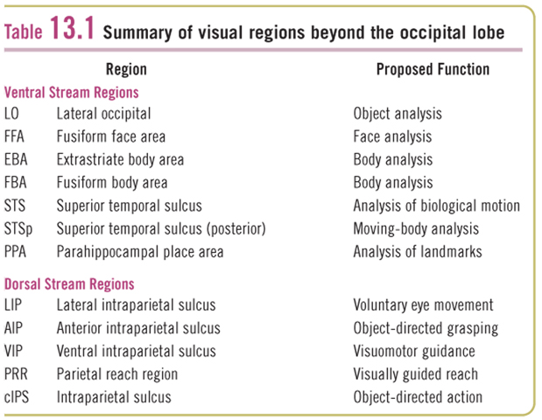

Slide 5
Ventral pathway

Slide 6
V4

Slide 7
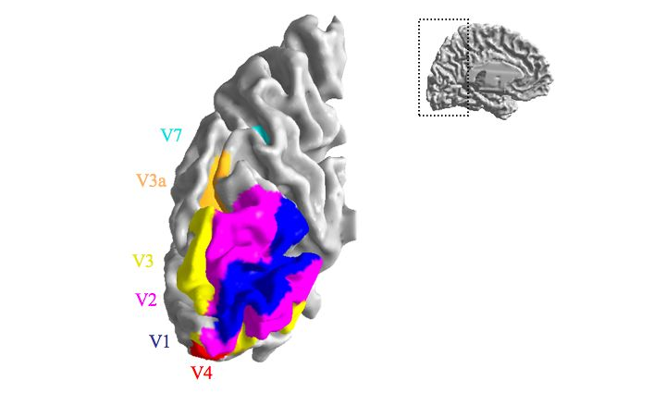
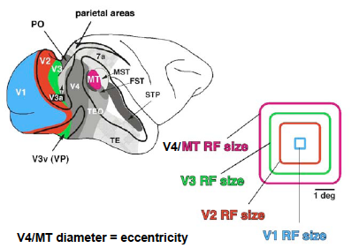

Slide 8
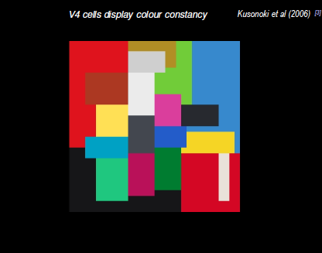
V4
Zeki

Slide 9
Area V4
Colour recognition
Individual neurones in V4 respond to a variety of wavelengths
Also some coding for orientation (may be colour specific)
PET studies show
more activation in V4 to coloured pattern than to grey tone
no difference if coloured pattern is stationary or moving
Achromatopsia
damage to V4 causes an inability to perceive colour
patients “see the world in black and white”
also an inability to imagine or remember colour

Slide 10
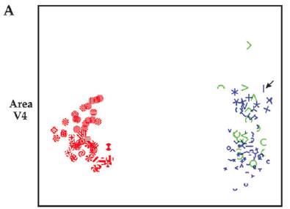
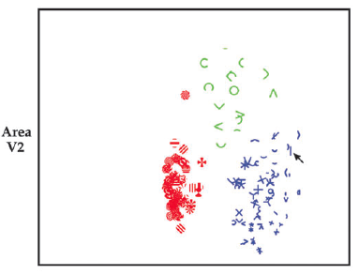
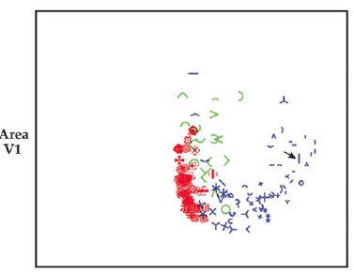
Multidimensional scaling
Hegde and van Essen,2006

Slide 11
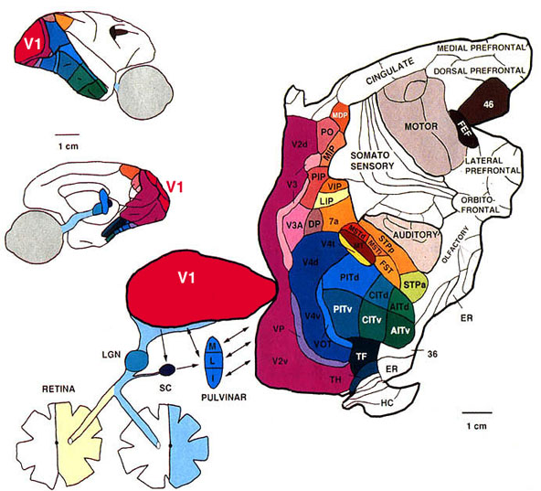
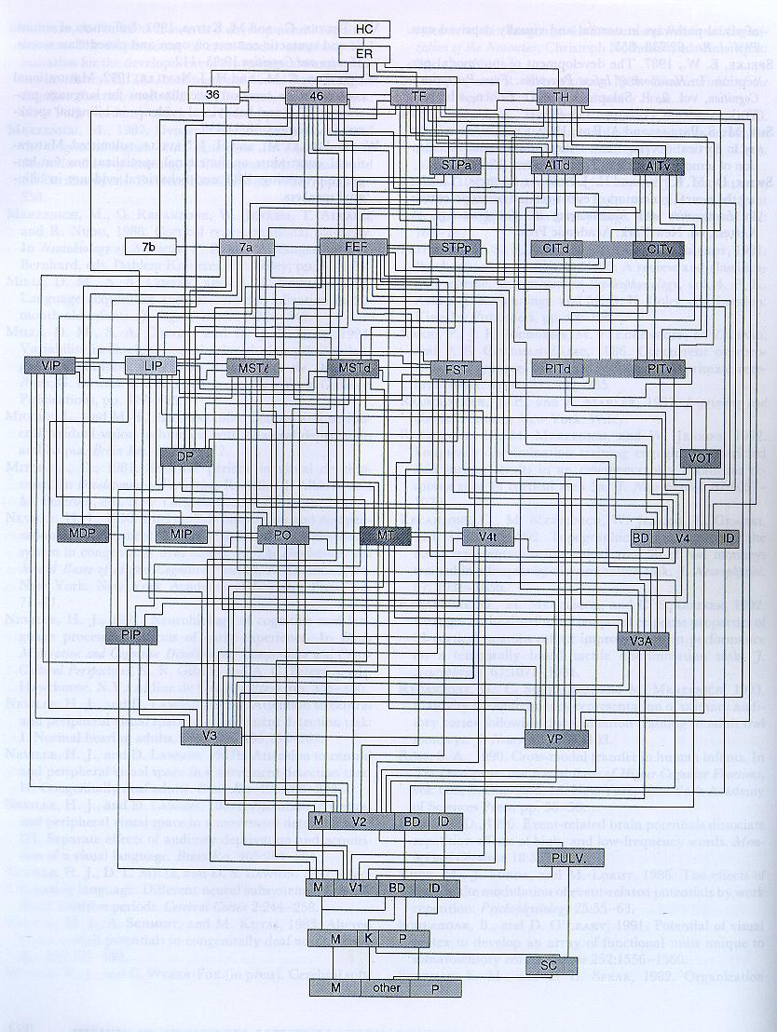
The inferotemporal cortex

Slide 12
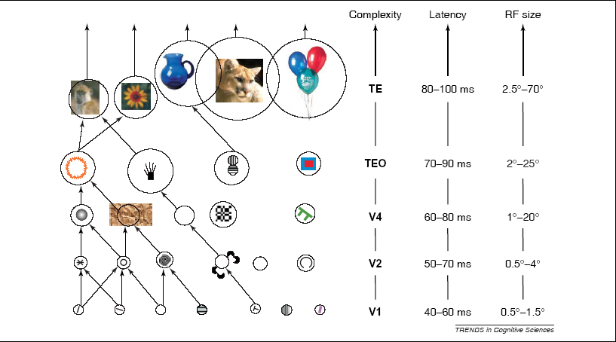
Computational Problems in Object Recognition
Hierarchical coding hypothesis
Object defined by Gnostic (or grandmother) cell? single neuron that represents"granny" activated by outputs from increasingly more complex detectors. NO!

Slide 14
Tamura and Tanaka, 2001
Complex shapes

Slide 15
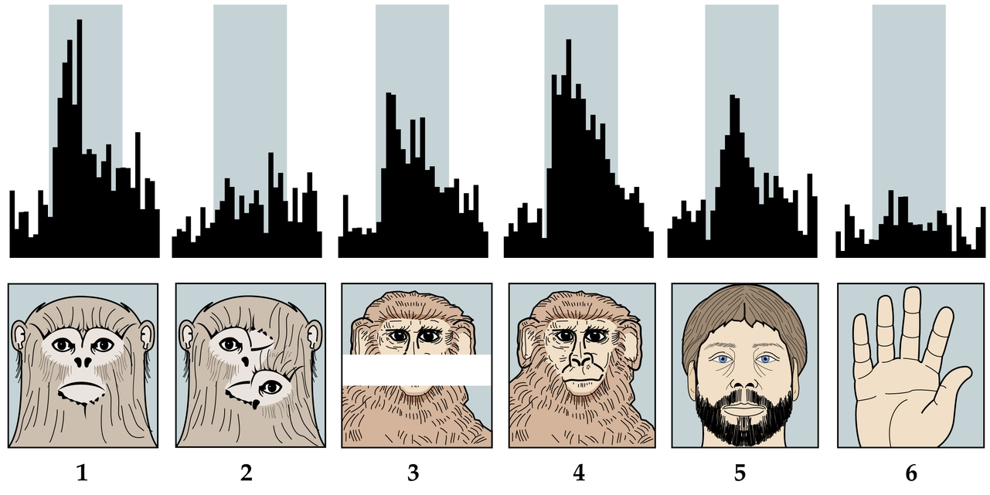
Face Selective Cells

Slide 16
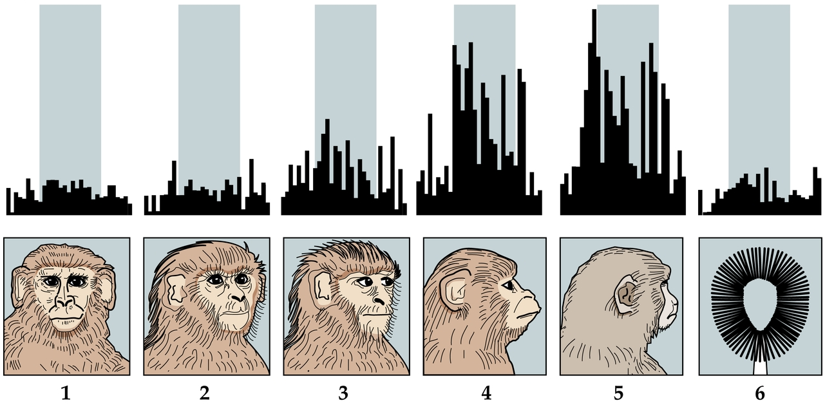
Face sensitive cells are often view dependent

Slide 17
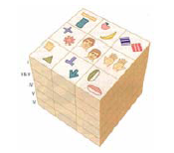
Tanaka
-clustering of similar cells
-Columnar organization

Slide 18
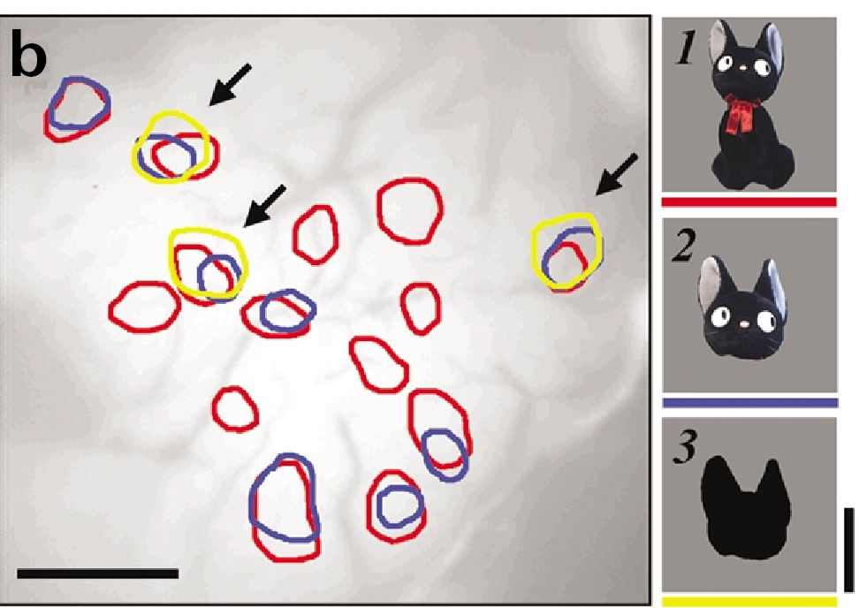
Tsunoda et al, 2001
-Different, but related features
activate overlapping columns

Slide 19
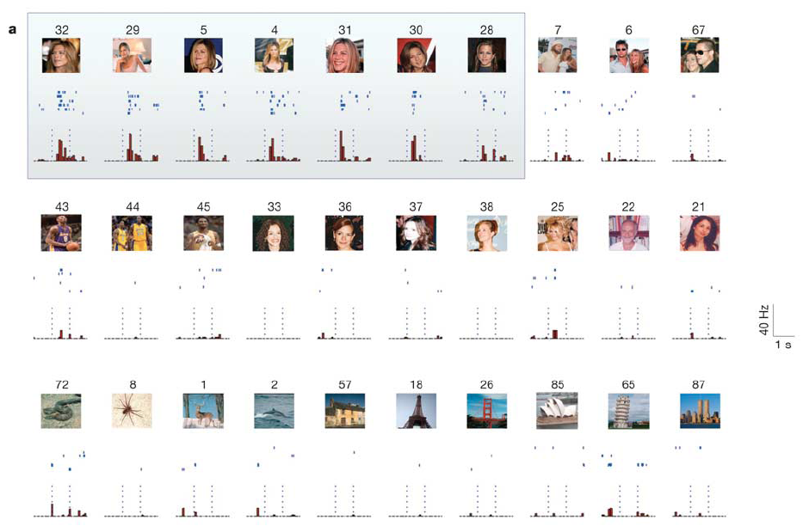
-Coding Quiroga et al, 2005
-Gnostic units?
Cardinal or pontificial neurons-grandmother cells
1 neuron – 1shape?
NO!
1 neuron - n shapes? (see before)
n neurons – 1 shape? ...

Slide 20
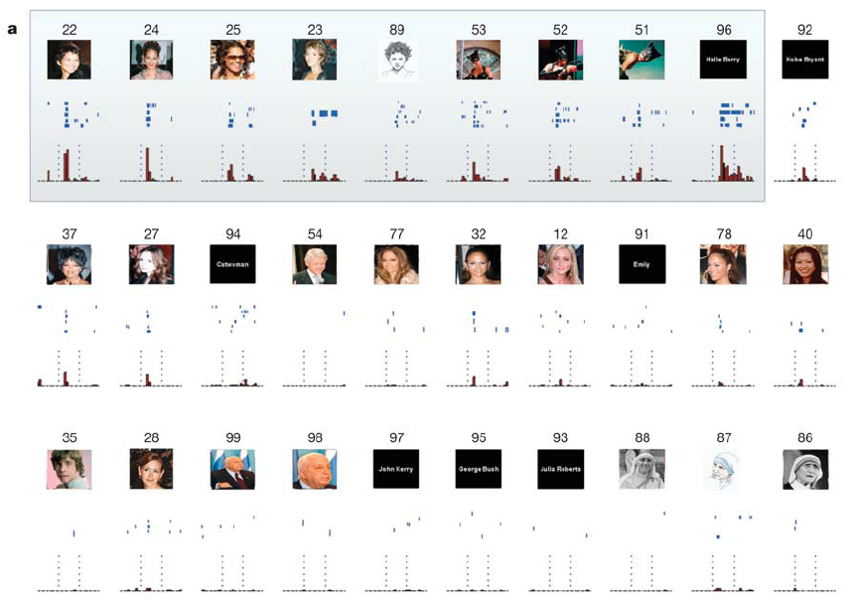

Slide 22
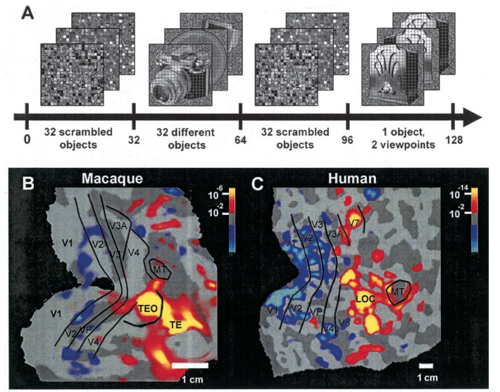
Tootel et al, 2003

Slide 23
Human ventral areas
LO- Lateral occipital cortex
FFA- fusiform face area
OFA- occipital face area
EBA – extrastriate body area
FBA- fusiform body area
PPA- parahippocampal place area

Slide 24
FFA - human

Slide 25
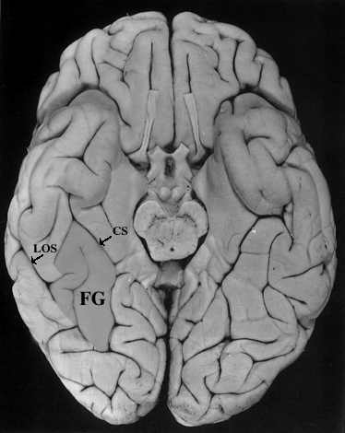
fMRI: FFA- fusiform face area
We contrast the activations obtained during presentation of faces with that of other
Objects or scrambled faces
Nancy Kanwisher (MIT)

Slide 26
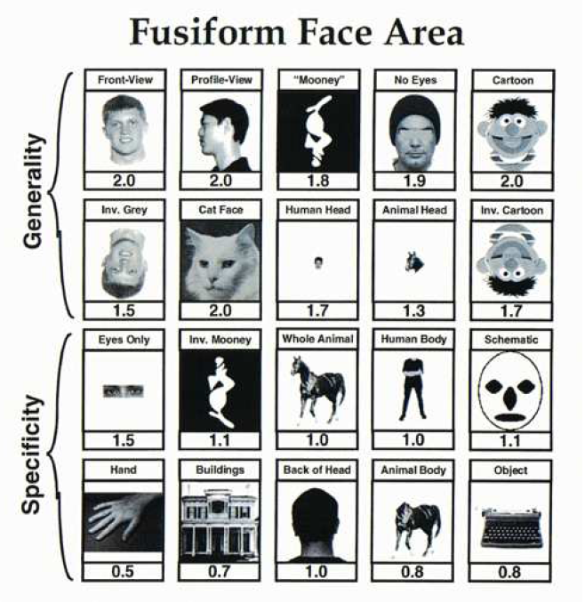

Slide 27
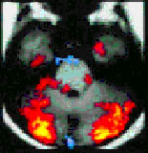
What activates the FFA?
Kanwisher & her colleagues have probed the type of stimuli that activate this region
Strong response: Frontal shots, profiles, cartoon faces, inverted faces?!, inverted cartoon faces, cat faces, faces with no eyes, & eyes alone.
Weak response: Schematic faces, animal bodies, houses, back of head.
FFA appears broadly tuned to face like stimuli

Slide 28
What activates FFA?
A face is the sum of…
External features parts configuration

Slide 29
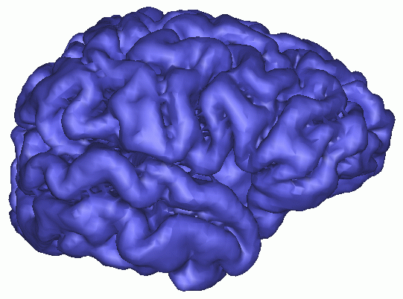
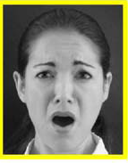
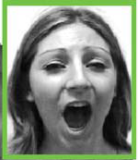
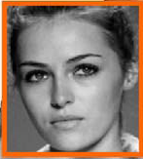
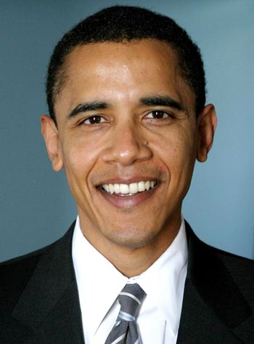
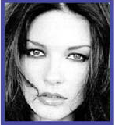
Lip movements
Eye-gaze
Expressions
STS
IFG
IOG
AMG
OFC
Attractivity
FFA
Social
Image description
Identity, fame

Slide 30
Face Network
Zhen and Liu, 2013

Slide 31
EBA- human

Slide 32
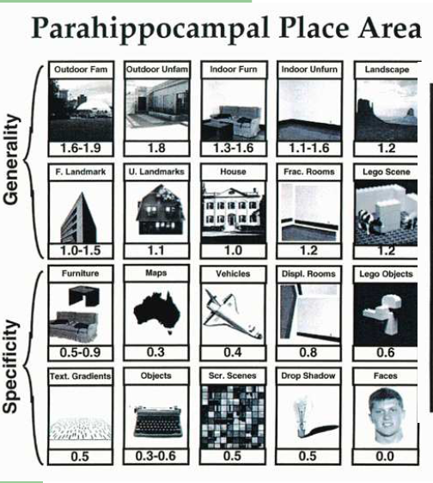

Slide 33
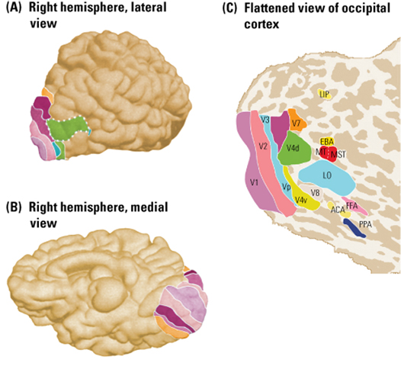

Slide 34
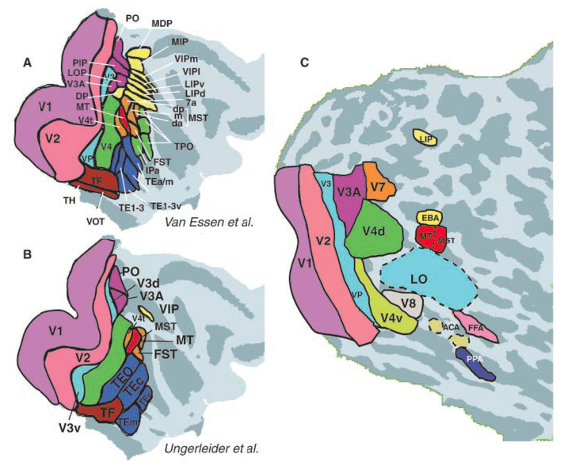
Tootel et al, 2003

Slide 35
LOC- human

Slide 36
Dorsal pathway

Slide 37
MT

Slide 39
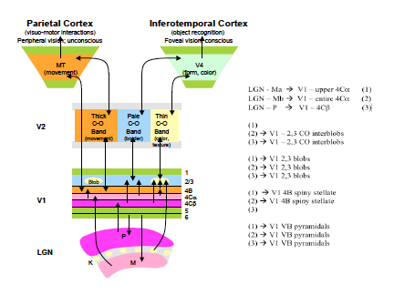

Slide 40
MT
IT
Thick
Pale
Thin
V2
1
2-3
4b
4c-a
4c-b
5
6
V1
M
CGL
K
P

Slide 41
Motion selectivity in V1 and MT

Slide 42
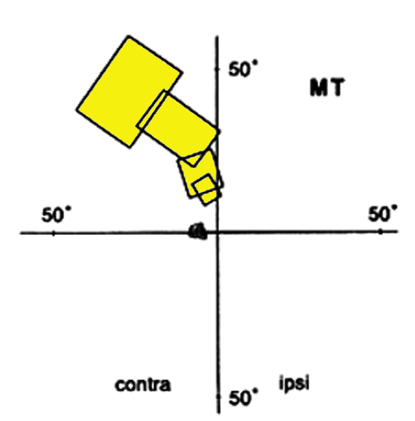
Receptive Fields in Area MT
MT neurons have medium-sized receptive fields (5-10 fold larger than in V1) which increase with eccentricity.
Contains a coarse retinotopic map of the
contralateral visual field.
Most MT neurons are not selective for form
but are tuned to:
direction of motion
speed of motion
binocular disparity (depth)
fovea
from Tanaka, 1998

Slide 43
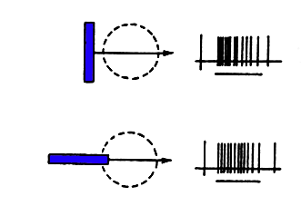
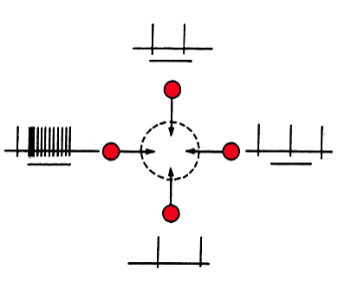
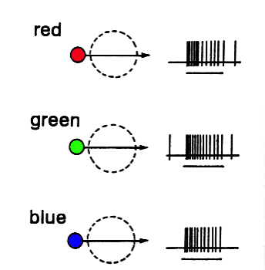
MT Neurons Are Selective for the Direction of Motion
but not Color and Orientation
Preferred direction
From Tanaka, 1998

Slide 44
A neural model for motion detection
A
B
C
D
E
F
receptors
excitation
inhibition
Direction Selective
Neuron

Slide 45
the cell will not respond to
left to right movement
A
B
C
D
E
F
receptors
excitation
inhibition
Direction Selective
Neuron

Slide 46
the cell will not respond to
left to right movement
A
B
C
D
E
F
receptors
excitation
inhibition
Direction Selective
Neuron

Slide 47
the cell will not respond to
left to right movement
A
B
C
D
E
F
receptors
excitation
inhibition
X
Direction Selective
Neuron

Slide 48
the cell will not respond to
left to right movement
A
B
C
D
E
F
receptors
excitation
inhibition
X
Direction Selective
Neuron

Slide 49
the cell will not respond to
left to right movement
A
B
C
D
E
F
receptors
excitation
inhibition
X
X
Direction Selective
Neuron

Slide 50
the cell will not respond to
left to right movement
A
B
C
D
E
F
receptors
excitation
inhibition
X
X
X
Direction Selective
Neuron
X

Slide 51
the cell will respond to
left to right movement
A
B
C
D
E
F
receptors
excitation
inhibition
Direction Selective
Neuron
X

Slide 52
the cell will respond to
left to right movement
A
B
C
D
E
F
receptors
excitation
inhibition
Direction Selective
Neuron

Slide 53
the cell will respond to
left to right movement
A
B
C
D
E
F
receptors
excitation
inhibition
Direction Selective
Neuron

Slide 54
the cell will respond to
left to right movement
A
B
C
D
E
F
receptors
excitation
inhibition
Direction Selective
Neuron

Slide 55
the cell will respond to
left to right movement
A
B
C
D
E
F
receptors
excitation
inhibition
Direction Selective
Neuron

Slide 56
the cell will respond to
left to right movement
A
B
C
D
E
F
receptors
excitation
inhibition
Direction Selective
Neuron

Slide 57
the cell will respond to
right to left movement
A
B
C
D
E
F
receptors
excitation
inhibition
Direction Selective
Neuron

Slide 58
Incidence of Directionally Selective Neurons in Monkey Cortex
100
MT
75
Percent Selective Neurons (%)
50
V3
25
V1
V2
V4
0
Directionally selective neurons are present in several regions of visual cortex
but are most numerous in area MT
adapted from Felleman & Van Essen (1987)
and Levitt et al 1997

Slide 59
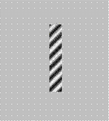
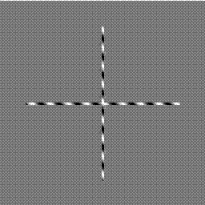
Aperture problem

Slide 60
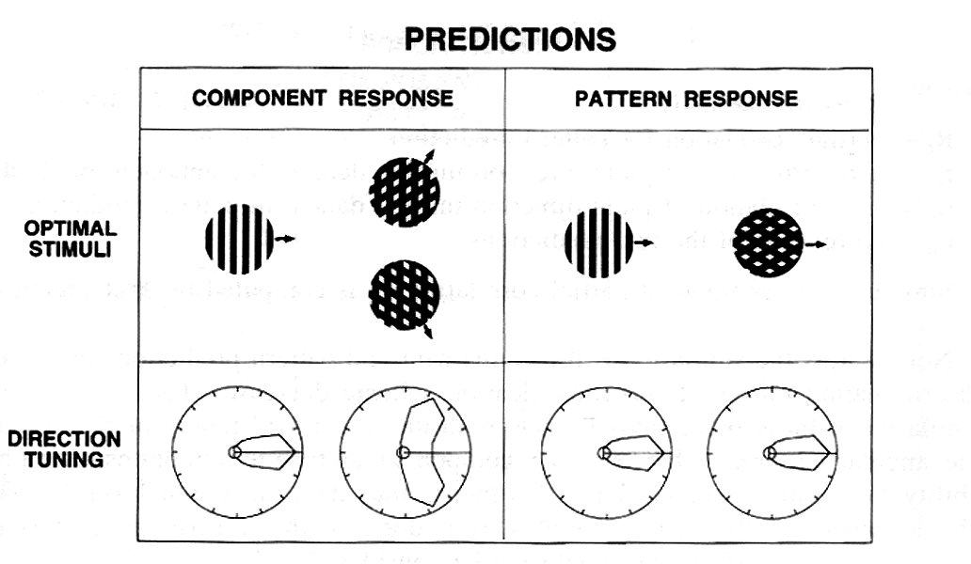

Slide 64
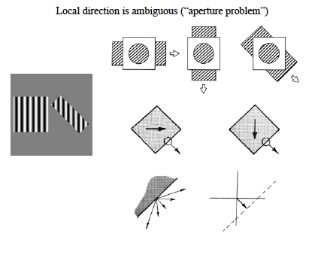
Difference of V1 and MT
http://www.michaelbach.de/ot/

Slide 65
Huk and Heeger, 2006

Slide 66
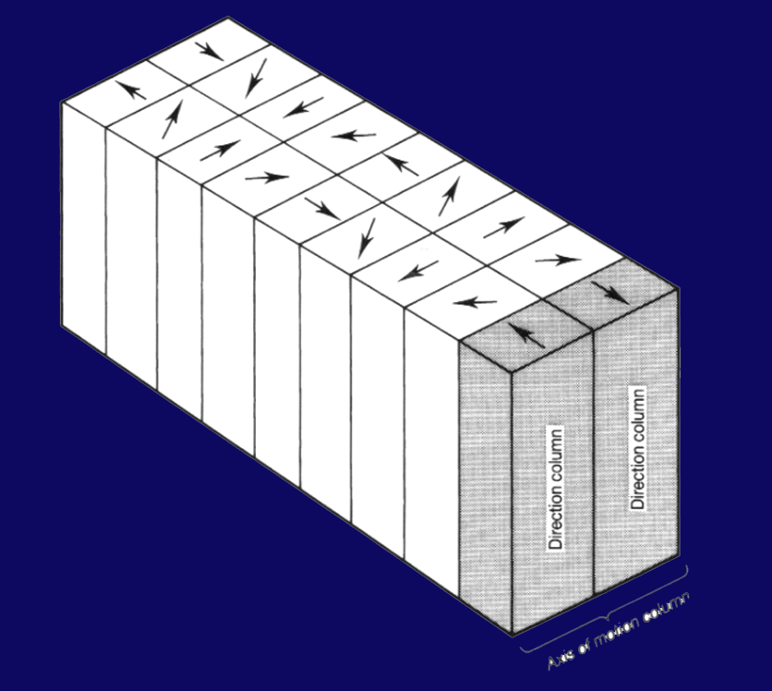
MT is columnar
Axis of motion column
from Albright et al 1984

Slide 67
Motion aftereffect
http://http://www.georgemather.com/MotionDemos/MAEMP4.html

Slide 68
Motion aftereffect
Aristotheles b(cca. 350 BC) Parva Naturalia.
Addams, R. (1834). An account of a peculiar optical phenomenon seen after having looked at a moving body. London and Edinburgh Philosophical Magazine and Journal of Science, 5, 373–374
Notes:
Erre a legjobb példát az ún. Adaptáció után létrejött utóhatások adják: a legismertebb esetben (mozgási utóhatás) pl. hosszabb ideig nézve az adott irányba mozgó felszínt az egyébként statikus képet ellentétes irányban mozgónak fogjuk látni.
Ilyenkora fizikai inger nem változik, az érzékelt élmény mégis más lesz.

Slide 69
Measuring Complex Motion Perception
Coherence
100
Monkey 240
100%
90
Percent Correct (%)
80
50%
70
Threshold
60
4
5
6
7
8
9
10
20
25%
Motion Coherence (%)
Slide from T. Pasternak

Slide 70
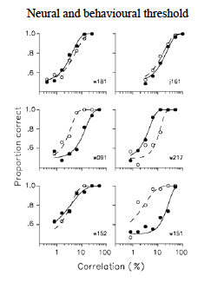
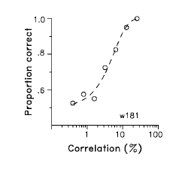
Behaviour
Neural response

Slide 71
Slide from T. Pasternak
Properties of MT neurons
MT contains representation of the contralateral receptive field
receptive fields are localized and increase with eccentricity
Most MT neurons are selective for direction & speed of stimulus motion
Directionally selective neurons are organized in columns
Responses of MT neurons are strongly modulated by stimuli placed
in the surround (relative motion)
MT neurons respond to relatively low spatial frequency, have high
contrast sensitivity and are broadly tuned to temporal frequency
Spatial limits of MT receptive fields increase with eccentricity
MT neurons are capable of integrating local motion vectors
Many properties of MT neurons parallel perceptual phenomena
Signals provided by MT neurons are used in the performance of motion tasks

Slide 72
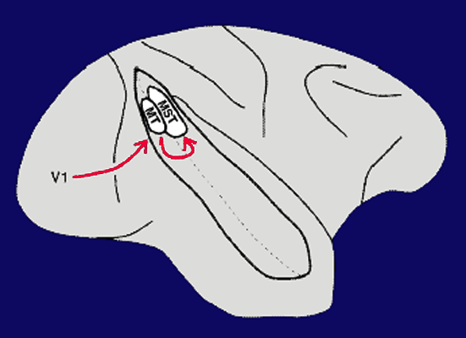
MST

Slide 73
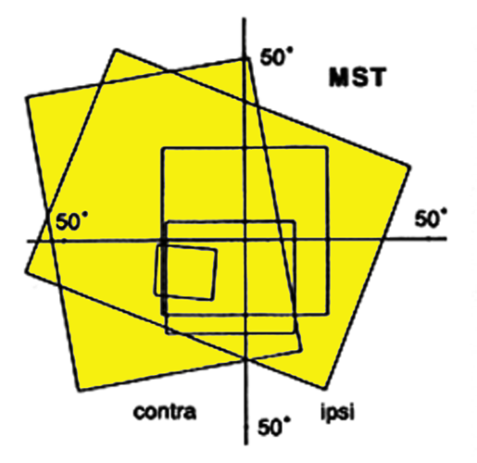
Receptive Fields in Area MST
Receptive fields in MST are larger than those in MT and include the fovea

Slide 74
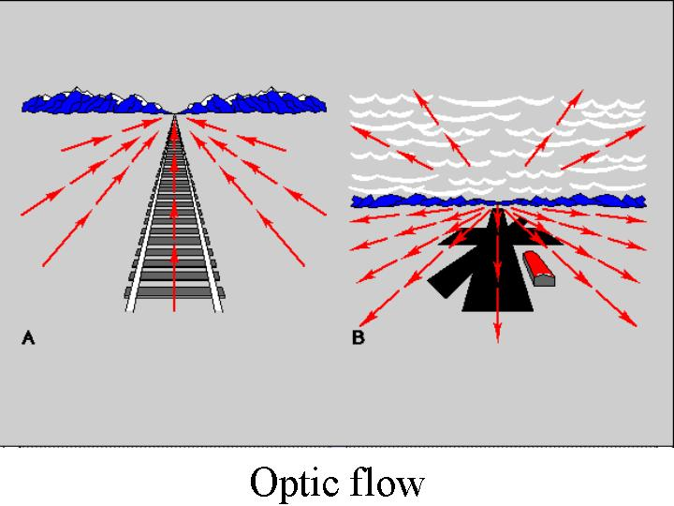
Optic flow
MST is sensitive to optic flow

Slide 75
Human MT (hMT+)
dAvossa et al, 2007

Slide 76
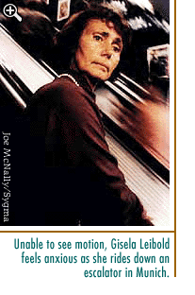
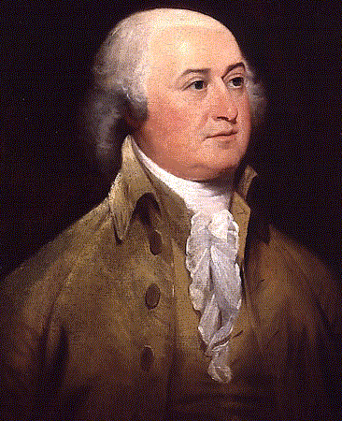
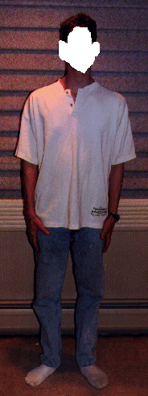
Akinetopsia
Akinetopsia J. Zihl. (LMU)
prosopagnosia

Slide 77
Posterior parietal cortex
Attention
Coordinate transformation
Multimodal
Intentions
Astafiev et al, 2003

Slide 78
What are the units of attentional selection?
Does attention select:
Location
Objects
Features
Note: These are not mutually exclusive.
Notes:
Test: when you try to select a particular feature at particular location, what else comes along fo the ride?
Other features at same location → location
Other features in the same object → object
Other stimuli sharing the same features → features
Neural responses good to answer this question

Slide 79
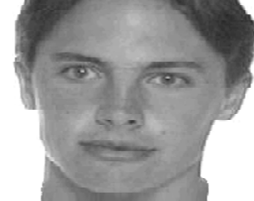
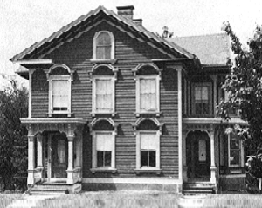
What are the units of attentional selection? → Location
PREDICTION OF LOCATION-BASED ATTENTION:
All the visual information at the attended location will be enhanced, whether task-relevant or not.
For example, in this stimulus:
Notes:
attention to red oval >> enhancement of representation of face
attention to green oval >> enhancement of representation of house
•stimuli like this appear for 160 ms, once every 2 sec in a random order
•Ss fixate the center dot; attend to the red oval or green oval (cued by block)
• Ss report orientation of attended oval
• faces and houses are never task relevant
• all stimulus conditions randomly interleaved

Slide 80
What are the units of attentional selection? → Location
Downing and Kanwisher (2001)

Slide 81
What are the units of attentional selection? → Objects
PREDICTION OF OBJECT-BASED ATTENTION:
All the visual attributes of the attended object will be enhanced, whether task-relevant or not.
For example, in this stimulus:
faces moves back and forth
(motion)
house remains stationary and is
slightly off center (position)
Notes:
attention to motion >> enhancement of representation of face attention to position >> enhancement of representation of house
stimuli like this appear for 200 ms, once every 2 sec
•either face moves,or house moves in a random order
•Ss fixate the center dot; attend to motion or position (cued by block)
• faces and houses never task relevant
• all visual features are superimposed in the same location

Slide 82
What are the units of attentional selection? → Objects
O’Craven, Downing & Kanwisher (1999)

Slide 83
What are the units of attentional selection? → FEATURES
PREDICTION OF FEATURE-BASED ATTENTION:
Attention to a given feature in a given location will enhance responses of that same feature elsewhere in the visual field
For example in this
stimulus:
Subjects need to indicate
Which stimulus has the
faster motion

Slide 84
What are the units of attentional selection? → Features
Saenz et al. 2002

Slide 85
What are the units of attentional selection?
locations?
enhancement of irrelevant
information at the same location
objects?
enhancement of irrelevant
attributes of target object
features?
enhancement of irrelevant
objects sharing features with the
target object.
Duncan & Desimone’s “biased competition” model:
stimuli with common object, location, or feature “stick together” in the competition.

Slide 86
Did you want to study vision?

