Slide 1
Notes:
TESZT

Slide 2
Notes:
TESZT2

Slide 3
DOPAMINE
Notes:
dopamin

Slide 4
HUMOUR PERCEPTION IN SCHIZOPHRENIA PRAGMATICS AND COGNITIVE LINGUISTICS
Victoria Lyakhova
02 December 2019
Budapest University of Technology and Economics
Department of Cognitive Science

Slide 5
DIMINISHED HUMOUR PERCEPTION IN SCHIZOPHRENIA: RELATIONSHIP TO SOCIAL AND COGNITIVE FUNCTIONING
J. Polimeni
D. Campbell
D. Gill
B. Sawatzky
J. Reiss
2009

Slide 6
HUMOUR...
.....reflects a set of incongruous beliefs
.....involves repressed sexual or aggressive impulses
.....elevates social status by expressing superiority or saving face
Notes:
Most of these evolutionary hypotheses
concentrate on humour’s general ability to enhance social
cooperation (Polimeni and Reiss, 2006b; Jung, 2003).
Since Ancient Greece, philosophers and scientists

Slide 7
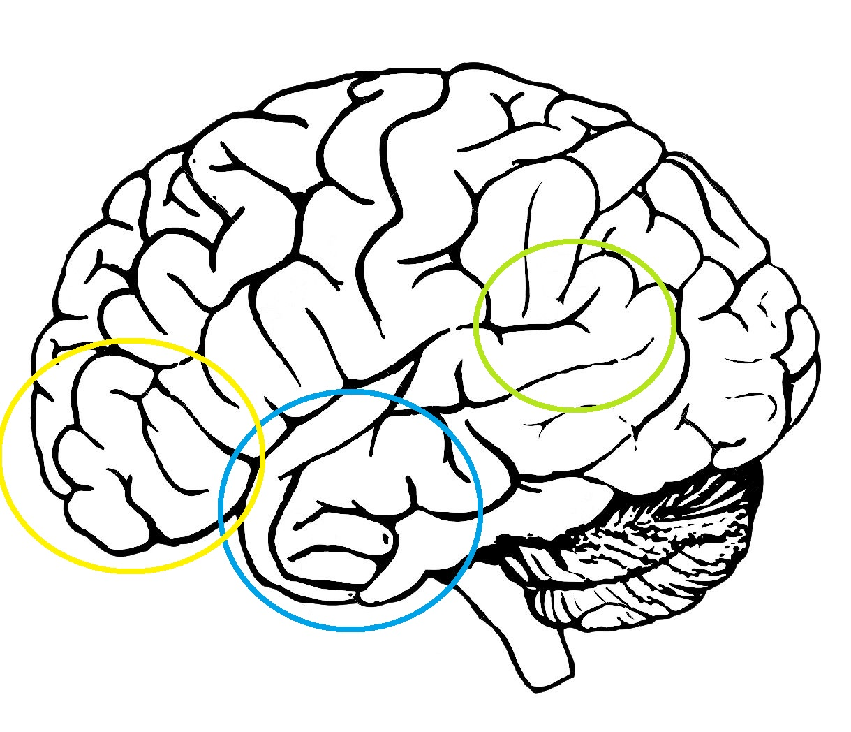
BRAAAAAINS
Left temporo-parietal junction
Left anterior temporal lobe
Left inferior frontal cortex
Notes:
The left temporoparietal junction (lTPJ) contains both Wernicke's area and the angular gyrus,

Slide 8
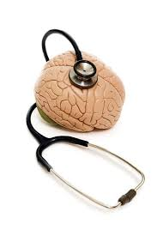
THE STUDY
Previous research
schizophrenia vs. healthy control
Solution
Additional comparison to
psychiatric non-schizophrenic
controls in order to exlude
effects of depression/anxiety
Notes:
1. A pozitív eredmény azt jelentené, hogy a humor felismerésének
a hiánya nem tükrözi az általános pszichiátriai tapasztalatokat (pl.
a társadalmi interakciók és a mindennapok zavarai,
belépés a mentális egészségügyi rendszerbe és a pszichiátriai kezelés) vagy általános érzelmi zavar (például a depresszió vagy szorongás tünetei).
2. Ez utalna a humor károsodott felismerésének alapjául szolgáló kognitív komponensekre skizofréniánál

Slide 9
THE STUDY
N=60
20: outpatients with schizophrenia
20: psychiatric control group
20: healthy control group
Tasks
Self-report questionnaires
Cognitive tests
Humour task
Notes:
1. outpatient = ambuláns beteg
A diagnosis
of schizophrenia by DSM-IV-TR criteria (APA, 2000) was confirmed
by one of two Psychiatrists (J.P.R. and J.P.) using the Mini
International Neuropsychiatric Interview (M.I.N.I.
Positive and Negative Symptoms of Schizophrenia Scale
Calgary Depression Scale for Schizophrenia
(CDSS; Addington et al., 1992), and Hamilton Depression Inventory
(HAM-D; Hamilton, 1960). All 20 patients were taking
antipsychotic medication at the time of testing (18 atypical, 1 typical,
1 both typical and atypical). Mean chlorpromazine equivalent
dose of antipsychotic medication was 358 mg/day (SD 390 mg/
day). HAM-D scores fell within the normal to mildly depressed
range of 0–13.
2. Eighteen of the 20 participants
in the psychiatric control group had described a recent history of
appreciable dysphoria (i.e., depressive disorder, adjustment disorder
with depressed mood, post-traumatic stress disorder).

Slide 10
SELF-REPORT QUESTIONNAIRES
Social Functioning Scale
Social Interaction Anxiety Scale
Revised Social Anhedonia Scale
Snaith–Hamilton Pleasure Scale
Social Adaptation Self-Evaluation Scale
Notes:
Social Functioning Scale (SFS;
Birchwood et al., 1990); Social Interaction Anxiety Scale (SIAS;
Mattick and Clarke, 1998); Revised Social Anhedonia Scale (RSAS;
Eckblad et al., 1982); Snaith–Hamilton Pleasure Scale (SHAPS; Snaith
et al., 1995) and the Social Adaptation Self-Evaluation Scale
(SASS; Bosc et al., 1997).
The SFS is a self-report questionnaire
developed for outpatients with schizophrenia. The SIAS is a self-report
questionnaire that measures subjective anxiety during social
situations. The RSAS is a true–false questionnaire that measures
diminished pleasure derived from interpersonal interactions. The
SHAPS measures the present state of anhedonia. The SASS is selfreport
inventory to assess level of social adjustment.

Slide 11
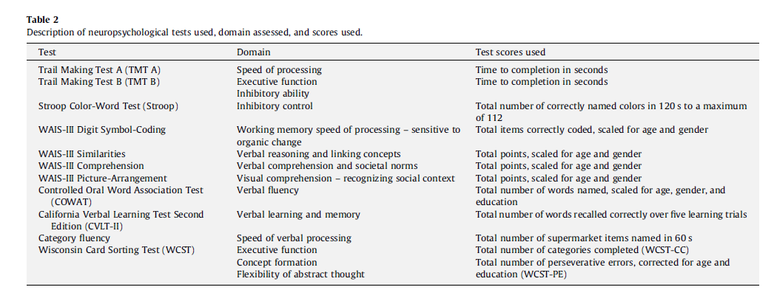
COGNITIVE TESTS
National Adult Reading Test
Wisconsin Card Sorting Test
Controlled Oral Word Association Test
A category fluency test
Stroop Color-WordTest
Trail Making Test A and B
California Verbal Learning Test-II
Wechsler Adult Intelligence Scale
WAIS-III Digit Symbol-Coding
WAIS-III Picture-Arrangement
WAIS-III Similarities
WAIS-III Comprehension
Notes:
National Adult Reading Test (NART; Nelson and Willison,
1991; Morrison et al., 2000), Wisconsin Card Sorting Test (WCST;
Heaton, 1981); Controlled Oral Word Association Test (COWAT;
Benton et al., 1983); a category fluency test; Stroop Color-Word
Test (Stroop; Trenerry, 1989); Trail Making Test A and B (TMT-A/B;
Reiten, 1971); California Verbal Learning Test-II (CVLT-II; Delis
et al., 2000); WAIS-III Digit Symbol-Coding; WAIS-III Picture-
Arrangement; WAIS-III Similarities, and WAIS-III Comprehension
(Wechsler, 1997). Wechsler Adult Intelligence Scale

Slide 12
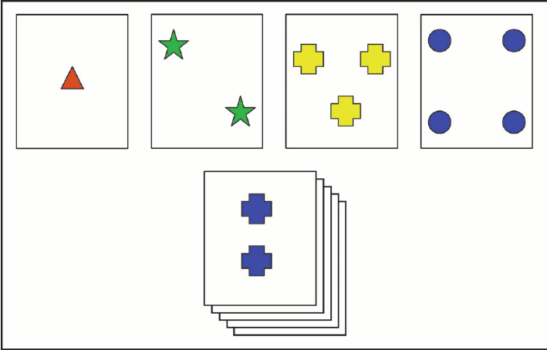
WCST
Schizophrenic subjects:
perseverate relative to
Controls (Butler et al, 1992), (Pantelis et al, 1999)
>> Poor attentional set shifting
Notes:
Külön említést érdemel a WCST
A recent study suggested that WCST might be helpful to differentiate
bipolar disorder from schizophrenia (Wobrock et al., 2008).

Slide 13
THE GIST OF IT ALL ─ THE HUMOUR TASK
64 black & white cartoon comics
32
original form
32
the original captions replaced by a non-funny, but relevant caption
Task:
Participants were instructed to judge each comic as either original or altered
Important: participants were not to judge whether they found the comic amusing, but whether the comic was in its original form and intended to be funny
Notes:
↙ ↘:
32 original form 32: the original caption replaced by a non-funny, but relevant caption
Task:
Participants were instructed to judge each comic
as either original or altered.
Important:
participants were not to judge whether they found the comic
amusing, but whether the comic was in its original form and intended
to be funny.

Slide 14
HYPOTHESES
Schizophrenia: diminished humour perception due to impaired cognitive abilities
Diminished humour perception cannot be attributed to depression, anxiety and other factors accompanying the being in psychiatric care
Notes:
As predicted,
the schizophrenia group showed significant and substantial
deficits in humour recognition compared to the healthy group,
t(38) = 5.1, P < 0.001, ES = 1.55. Equally important, was that the
schizophrenia group’s humour recognition performance was also
poorer than that of the psychiatric control group,
executive
functioning deficits may be a major factor underlying social
impairment associated with schizophrenia.

Slide 15
ANALYSES
ANOVA
Post-hoc t-tests
ANCOVA

Slide 16
RESULTS
Cognitive performance comparisons
no difference - NART, category fluency, word association, verbal reasoning
difference – WM, RT, EF, complex cognitive functions, social reasoning
Anhedonia and social functioning questionnaires
Anhedonia: SG < PG
Social adjustment: SG > PG
Humour recognition
SG < PG, HC
PG = HC

Slide 17
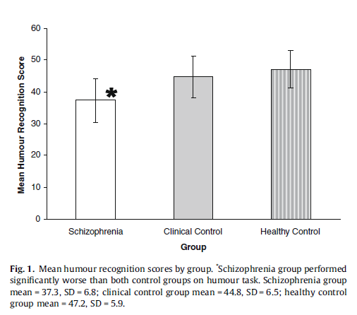
RESULTS
Humour and clinical measures
Clinical symptomology ∝ humour perception
Cognitive correlates of humour recognition
SG: humour recognition correlates with general intellectual functioning, social reasoning, EF
Social correlates of humour recognition
social adjustment ∝ humour recognition
social anxiety ↓ humour recognition ↑
anhedonia ⟂ humour recognition

Slide 18
DISCUSSION
Analysing humour as a cognitive domain → undiscloses mechanisms of schizophrenia

Slide 19
CRITICISM
Limitations
No bonferroni correction
Modest sample size → type 2 error?
NART instead of direct IQ – not a threat
Does not take into account the affective component of humour
Medications and antipsychotics (chlorpromazine)
Notes:
First, because this is an exploratory
study, we have purposely not utilized a Bonferroni correction
for the multiple correlations between cognitive tests and
humour performance.
National Adult Reading Test
Other tests,
for instance, have sometimes measured laughter responses.
The sedative or
anticholinergic effects of some psychiatric medications can perhaps
lessen cognitive performance.
Additionally, it could be argued that medication usage might
have, in fact, minimized any real differences in humour perception
scores between the groups

Slide 20
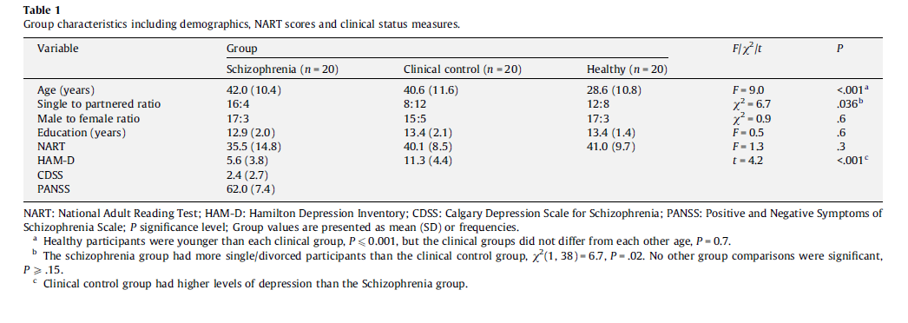
CRITICISM
Notes:
First, because this is an exploratory
study, we have purposely not utilized a Bonferroni correction
for the multiple correlations between cognitive tests and
humour performance.
National Adult Reading Test
Other tests,
for instance, have sometimes measured laughter responses.
The sedative or
anticholinergic effects of some psychiatric medications can perhaps
lessen cognitive performance.
Additionally, it could be argued that medication usage might
have, in fact, minimized any real differences in humour perception
scores between the groups

Slide 21
FURTHER STEPS
Neuroimaging investigations
Long-term studies evaluating the stability and predictive utility of humour deficits over time
The proposal to include humour measures in cognitive-emotional remediation and/or pharmacological trials to better appreciate the pathophysiology and clinical significance of humour perception deficits in schizophrenia

Slide 22
CONCLUSIONS
Humour recognition deficits in schizophrenia: confirmed
This attrition is specific to schizophrenia

Slide 23
THANK YOU!

