Slide 2
HUMOUR AND SCHIZOFRENIA PRAGMATICS AND COGNITIVE LINGUISTICS
Victoria Lyakhova
02 December 2019
Budapest University of Technology and Economics
Department of Cognitive Science

Slide 3
DID SOMEONE JUST SAY HUMOUR?
Latin: humor, i.e. "body fluid“
Humoral regulation. Basically, all fluids intact → the world becomes a fun and funny place
Evolutionary sense?
Self branding: intellectual abilities
Men: showing dominance
Women: showing a healthy state

Slide 4
TYPES OF HUMOUR INCLUDING BUT NOT LIMITED TO
Anecdotes
Irony
Jokes
Observational
Quote
Role play
Self-deprecation
Vulgarity
Word play
Other
Notes:
Observational comedy – stand-up, everyday situations

Slide 5
BRITISH HUMOUR
Satire aimed at "the absurdity of everyday“
Class system, social and sexual taboos
Common techniques include puns, innuendo and intellectual jokes
A strong theme of sarcasm and self-deprecation
Deadpan, dry humor or dry wit delivery manner

Slide 6
THE WORSE, THE MORE AMUSING?

Slide 7
WHAT'S SO FUNNY? MODELLING INCONGRUITY IN HUMOUR PRODUCTION.
Rachel Hull, Sümeyra Tosun & Jyotsna Vaid, 2016

Slide 8
HUMOUR IS COMPLEX
Humour depends on numerous factors
Context
Timing
Interlocutor
The audience
The target
Social acceptedness
Intentions
Notes:
Interlocutor – beszélő, narrátor
Intention - szándék

Slide 9
SEVERAL THEORIES
Censors in the mind repress the forbidden, jokes bypass them (Freud)
Humour serves to monitor and suppress bugs/ineffective thoughts in everyday reasoning (Minsky)
This view covers a broader range of humour
Social and political, exploiting stereotypes, righting wrongs (Vaid)
Common: an intrinsically rewarding experience

Slide 10
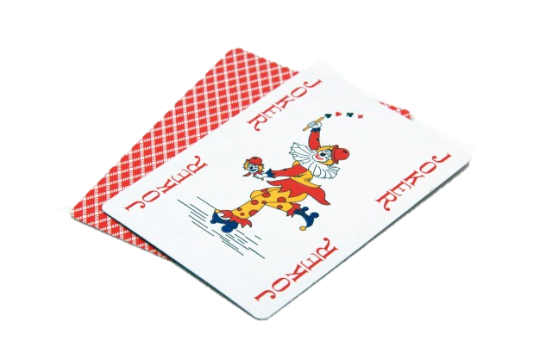
WHAT IS THE NOVELTY?
Previous research focuses mostly on humour perception
Hull et al.: humour initiation instead of perception
AIMS:
to examine actual instances of humour production
to examine the cognitive underpinnings of humour

Slide 11
THE STUDY
N=323
4 pairs of concepts
The task is to find differences or similarities (randomly assigned)

Slide 12
(MANIPULATED) VARIABLES
Within subjects variables
Concept relatedness
Between subjects variables
Gender
Task
Finding similarities vs. differences
Instructions
„Be funny” vs „Be catchy”
Affective salience
With or without taboo words
The dependent variable is perceived humourousness

Slide 13
HYPOTHESES EXPERIMENT 1
Explicit instructions to be funny → inhibiting effect
„be catchy”
Humour production: men > women
Taboo words: P (humorous responses) ↑
Incongruity ∝ humour

Slide 14
HYPOTHESES EXPERIMENT 2
Concept comparisons referring to a property for one concept more than the other in the stimulus pair are funnier
Output dominance
(Significantly different output dominance scores would produce more instances of responses judged funny)
There will be no significant difference in output dominance levels for the activated alignment property for items judged Not Funny.

Slide 15
METHOD EXPERIMENT 1
Phase 1
Humour elicitation via concept comparisons
Phase 2
Classification of Phase 1 responses as funny or not funny
Jury panel, then tallying of judgements

Slide 16
PRODUCING HUMOUR THROUGH PAIRED CONCEPTS

Slide 17
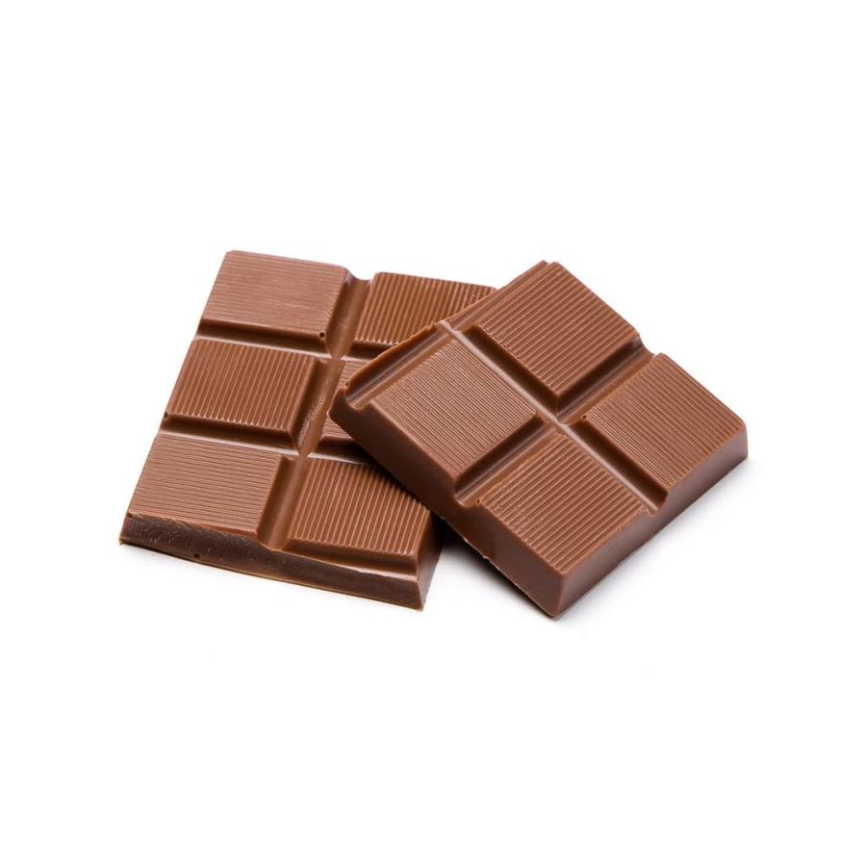
EXPERIMENT 2 FOLLOW-UP EXPERIMENT
How incongruity in structurally aligned properties predicts humour content in concept comparisons.
≠
Notes:
We expected the
mental reorganisation of understanding a punch line
to involve the sudden alignment (equalisation of dominance)
of previously misaligned properties, resulting
in that singular “aha moment”—and funniness.
Humour may be more likely to occur when
there is more cognitive distance between favoured
(output dominant) and surprising (unexpected)
interpretations of that aligning feature, such that the
feature’s default output dominance score will be
high for one concept and low for the other. This is
because properties high in output dominance function
as default fillers and presumably reflect the
most commonly activated mental representation of
a concept—and the one that would therefore be
initially activated during the setup stage of humour
processing (i.e. before the mental reorganisation
required to understand the punch line). For example,
the feature laugh is high in output dominance for
the concept joking, but significantly lower for the
concept cooking, so the default output dominance
scores for laugh would be considered misaligned for
the pair COOKING and JOKING.

Slide 18
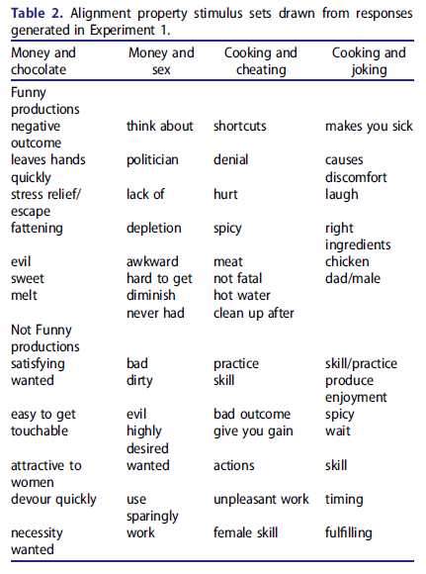
METHOD EXPERIMENT 2
Phase 1
Stimulus development and procedure
Identification of alignment properties
Generation of output lists for individual concepts
Phase 2
Determination of output dominance of features
Output dominance is assessed by examining the relative frequency of mention of different properties associated with a concept
Notes:
This experiment sought to establish whether funniness
can be predicted in terms of the relative output
dominance values for the property a response activates
to align two concepts (to draw a similarity or
difference between them).
Output dominance is
assessed by examining the relative frequency of
mention of different properties associated with a
concept.
Humour may be more likely to occur when
there is more cognitive distance between favoured
(output dominant) and surprising (unexpected)
interpretations of that aligning feature, such that the
feature’s default output dominance score will be
high for one concept and low for the other. This is
because properties high in output dominance function
as default fillers and presumably reflect the
most commonly activated mental representation of
a concept—and the one that would therefore be
initially activated during the setup stage of humour
processing (i.e. before the mental reorganisation
required to understand the punch line). For example,
the feature laugh is high in output dominance for
the concept joking, but significantly lower for the
concept cooking, so the default output dominance
scores for laugh would be considered misaligned for
the pair COOKING and JOKING.

Slide 19
RESULTS, EXPERIMENT 1
Explicit instructions to be funny → inhibiting effect
→ yes!
Gender
No main effect, but a gender x incidential condition
Men in the “be catchy” condition > men in the “be funny” condition
Women were just as funny as men in the “be catchy” = men
Women > men in the “be funny” condition.
Taboo words: P (humorous responses) ↑
No main effect, but salience x instructions approached significance, more evident under implicit conditions
Semantic relatedness (Incongruity ∝ humour)
Dissimilar concepts compared elicited more humour
Task
Main effect, finding differences > finding similarities
Task x instructions: significant effect only for differences

Slide 20
RESULTS, EXPERIMENT 2
Money and chocolate
Funny: 29%, no significance for not funny
Sex and money
Funny: 13%, 25%, no significance for not funny
Cooking and cheating
Funny: 38%, 25%, but also significant for not funny
Cooking and joking
Funny: 33%, no significance for not funny
→ Over 41% of Funny responses and over 97% Not Funny responses followed the predicted pattern (Hypothesis: significantly different output dominance scores would produce more instances of responses judged funny)

Slide 21
DISCUSSION
Humour responses were more evident under incidental than intentional humour production instructions
No gender difference
No clear effect of affectiveness, but strong in interactions
Incongruity has been considered a central mechanism underlying humour comprehension (Suls, 1972)

Slide 22
DISCUSSION
An independent method for predicting what comparisons are judged funny
+ where and how in verbal humour processing incongruity occurs in a concept juxtaposition context
Output dominance scores as a mechanism to quantify the cognitive distance
→ incongruity in terms of a measurable difference in default output dominance between aligned properties in the base and target of a humorous verbal production
The condition of „surprisingness” can be quantified
Notes:
Cognitively based models of humour processing invoke the notion of incongruity

Slide 23
CRITICISM
Catchy?
instantly appealing and memorable
The panel of judges: 4 undergraduate research assistants
4? 2?
Not representative, all from one Uni
WEIRD
The humour degree was not considered
Neutrality

Slide 24
FURTHER TOPICS TO RESEACH
Degrees of humour
Varied target populations (for example cognitive deficits)

Slide 25
IN A NUTSHELL
The centrality of incongruity resolution as a key cognitive
ingredient for humour
Notes:
The centrality of incongruity resolution as a key cognitive
ingredient for humour

Slide 26
THANK YOU!

