Slide 1
Clinical pragmatics

Slide 2
Problem areas
Reference and presupposition
Context-dependent disambiguation
Implicatures
Speech acts

Slide 3
Speech as an act
Some utterances are more than a description of a state-of-affairs:
  I have a gun. (threat)
  You’re an idiot. (insult)
  I need a pen. (request)
  I’ll settle my debt tomorrow. (promise)
  Pay up or you’ll see your pictures on the web. (blackmail)
If an utterance is not a description of the world, it cannot be interpreted with the tools of semantics in terms of truth values.

Slide 4
Direct versus indirect speech acts
It needs some more salt.
It’s tasteless!
I could do with a bit of salt.
Can you reach the salt?
Could you pass the salt?
Give me the salt!

Slide 5
Austin 1955, How to act with words
locution: the actual words used by the speaker and their semantic meaning
illocution: what the speaker is doing by uttering those words
perlocution: the actual result of the locution
a locution may express more than one illocution
perlocution may differ from illocution.

Slide 6
Searle (1971): Felicity conditions
A speech act is not true or false but felicitous or non-felicitous.
For a speech act to be felicitous, certain conditions must be met
  If you don’t stop that, I won’t eat my cake.
  the act cannot have the desired effect
  I’m ordering the sun to rise tomorrow.
  ignores the current state of the world
  I’ll/you should eradicate poverty in the world.
  the act cannot be performed
  I promise to punch you in the nose.
  mismatch between performative verb and intended act

Slide 7
The conditions are conventions similar to Grice’s maxims
content conditions: depends on speech act, e.g., requested or promised events must be future events
preparatory conditions: the promised act can be performed
sincerity condition: the illocutionary act is the speaker’s genuine intention
general conditions: the utterance must make sense to the speaker and the hearer

Slide 8
Assessment of pragmatic skills

Slide 9
Children’s Conversational Checklist (Bishop,1998)
70 items scored as “does not apply” (0), “applies somewhat” (1), and “definitely applies” (2).
Items fall into 9 categories:
  A. Speech intelligibility and fluency
  B. Syntax
  C. Inappropriate initiation
  D. Coherence
  E. Stereotyped conversation
  F. Use of conversational context
  G. Conversational rapport
  H. Social relationships
  I. Interests

Slide 10
Children’s Conversational Checklist
  Some example items:
  C. Inappropriate initiation
    Talks too much
    Keeps telling people things they know already
  D. Coherence
    Has difficulty telling a story, or describing what he has done, in an orderly sequence of events
    Uses terms like “he” and “it” without making clear what he is talking about

Slide 11
Children’s Conversational Checklist (cont)
  E. Stereotyped conversation
    Will suddenly change the topic of conversation
    Has favorite phrases and sentences which he will use a great deal, sometimes inappropriately
  F. Use of conversational context
    Tends to be over literal
    May say things which are tactless or socially inappropriate
  G. Conversational rapport
    Ignores conversational overtures from others
    Seldom or never looks at the person he is talking to

Slide 12
Children’s Conversational Checklist
Fairly good clinician inter-rater reliability and internal consistency -- in the .80 range.
Pragmatic composite score (the 38 items) discriminates significantly between autistic, pragmatic language impaired (Social Communication Disorder without autism), other SLI, and typically developing children.
Low correlations between teacher/clinician ratings and parent ratings (+.48 on pragmatic composite score)

Slide 13
Clinical populations
Developmental disorders:
  Specific language impairment
  Autistic spectrum disorders
  Mental retardation
  Emotional and behavioural problems (e.g. Attention Deficit Hyperactivity Disorder)
Acquired disorders
  stroke, brain tumour
  traumatic brain injury
  neurodegenerative disorders (e.g. Alzheimer, Parkinson)
  schizophrenia

Slide 14
Likely sources of pragmatic impairment
Structural linguistic impairment
  e.g. speech act deficiencies may be explained by an inability to form syntactically correct questions
Cognitive deficits
  speed of information processing, working memory
  impairments of executive functioning (sustaining attention, impulse control, flexibility)
  Impaired Theory of Mind skills

Slide 15
Developmental language disorder
Specific language impairment (SLI)
  poor language performance with normal nonverbal intelligence and normal hearing
  morphosyntactic deficits (Leonard et al 2003)
  object naming problems (McGregor et al 2002, Alt et al 2004)
  phonological deficits (Aguilar-Mediavilla et al. 2002)
  impaired phonological short term memory (non-word repetition) (Briscoe et al 2001)
  poorer verbal working memory capacity (in competing language processing task: T/F question + recall of last word or sentence)
  sluggish attention shifting (rapid serial visual presentation task: detect two consecutive target stimuli) (Lum et al 2007)
  pragmatics??

Slide 16
SLI pragmatics
inadequate conversational responses (Bishop et al 2000)
problems using context to understand implied meanings or to resolve ambiguity with the help of context, (Rinaldi 2000, Leinonen et al 2003)
is it a problem of rapid inferential processes?

Slide 17
Reference Specification -- Testing Procedure, de Villiers, 1988
Examiner and child play a referential communication game.
The child sees a picture that the examiner cannot see. S/he has to describe an event that is happening in part of the picture so that the examiner can pick out the person or object involved in the event from a set of similar people or objects.
In some trials there is a distinctive property that distinguishes the referent. In others it is the location or action of the referent that must be mentioned.
In this way the linguistic form that must be produced increases in complexity from adjectives to prepositional phrases and finally to relative clauses.

Slide 18
Here are two policemen.
c. The Psychological Corporation

Slide 19
Tell me what is happening in the red box. I need to know which policeman it is.
c. The Psychological Corporation

Slide 20
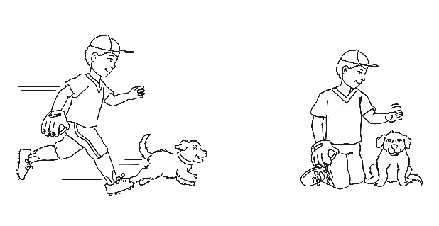
Here are two boys.
c. The Psychological Corporation

Slide 21
Tell me what is happening in the red box. I need to know which boy it is.
c. The Psychological Corporation

Slide 22
Development of reference specification in typically-developing and language-impaired children. Spontaneous production of form and function before any prompts.

Slide 23
Development of reference specification in typically-developing and language-impaired children. Production of form and function following all prompts.

Slide 24
Story comprehension: Ryder & Leinonen
Ben was having a bring-your-bear birthday party. He told Tom and Maxie and Rosie and Sue when they were out at the swings. They said they’d all come and they told their mums and their dads. “I’ve never heard of a bring-your-bear birthday party before” Maxie said. Tom and Maxie and Rosie and Sue made birthday cards for Ben. Sue made a big card shaped like a bear and a much smaller card to give from her teddy bear. Rosie said Ben was having a Big Bear, a real one, at his party. “Ben’s making it up”’ Maxie said. The bears needed special clothes for the party. Tom and Maxie and Rosie and Sue looked in Sue’s box of old dressing-up clothes for things to wear. “My bear will look best” Maxie said. “Because he’s the biggest!” Sue and her mum went shopping for Ben’s birthday present. They saw Tom and Maxie and Rosie at the shops. They were all looking for presents for Ben. Rosie said that the Big Bear would do tricks at Ben’s party. “Big Bears don’t do tricks,” Maxie said. “They live in the woods”. At playgroup they all sang “Happy Birthday, Dear Ben’” although Ben wasn’t four until the next day. Mrs. Samara gave Ben a kiss. Ben told Mrs. Samara that a big bear was coming to his party. Mrs. Samara said she’d once seen a big bear but she’d never met one at a party. She thought a big bear might scare the teddy bears. “Not my bear, “Maxie said “My bear is brave, just like me!’ At the party, Ben was dressed as Paddington Bear, with boots and a hat. There were lots of bear games, and bear eats and bear treats that were hidden. Tom and Rosie and Maxie and Sue all had to find them. “Where’s Ben’s big bear?” Maxie said. “I knew there wouldn’t be one!” Then, the door opened and in came Ben’s big bear! He went GRRRRRR! Maxie hid under the table. Rosie told Maxie not to be scared, it was just Ben’s dad dressed up. “I know that” Maxie said. “it was my bear who was scared, not me”. Maxie got used to the bear being there. He and Ben helped the Big Bear to do his tricks. They made Rosie’s small bear appear out of a hat. “I’ll do the magic words’” Maxie said. Tom and Rosie and Maxie and Sue sang, “Happy Birthday, Dear Ben,” and Ben blew out all the candles on his Bear-Cake all by himself. “I like this bear party’” said Rosie. “My bear says it’s the best bear party ever!” Maxie said.

Slide 25
Ryder & Leinonen Questions
Reference Questions
  Who sang Happy Birthday, Dear Ben?
  What did Tom and Rosie and Maxie and Sue have to find?
  Who made Rosie’s small bear appear out of a hat?
Enrichment Questions
  What is a bring-your-bear birthday party?
  What are special clothes?
  What tricks did the bear do?
Implicature Questions
  Where had Mrs. Samara seen a big bear?
  How did Maxie know there wasn’t going to be a big bear?
  Why did Maxie say it was his teddy bear who was scared?

Slide 26
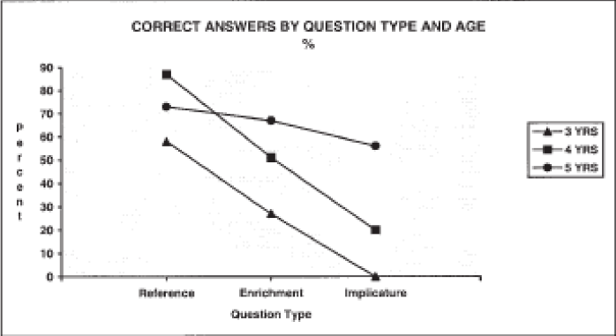
Ryder & Leinonen 2003
Leinonen et al 2003: children with SLI do worse than their age-matched controls

Slide 27
Left hemisphere damage
most common form of language impairment is aphasia: fluent (Wernike’s) or non-fluent (Broca’s)
pragmatic deficits also occur
  narrative coherence, discourse organisation (Coelho & Flewellyn 2003)
  Gricean implicatures in literally problematic two-sentence exchanges (Kasher et al 1999)
  also in non-verbal contexts: interpretation of metaphorical paintings

Slide 28
LHD and non-verbal implicatures (Cutica et al 2006)
shown story videos with an actor performing a gesture
Task: select a picture that represents the actor’s communicative intentions
patients do badly if the story involves deceit or irony

Slide 29
Direct acts: A child (A) is walking with her mother (B) along the road. A tags onto B’s dress and holds her arms up. The alternatives for A’s thought are
  (a) B picks A up
  (b) B washes A’s hands
  (c) A is carrying a doll
  (d) B looks at some plants
Simple deceits: In a classroom, children are doing math exercises. One child (A) is holding a book to hide the comic strips inside. The teacher (B) comes over, suspiciously. A hides the comics under the desk and shows the teacher her book. The alternatives for A’s thought are
  (a) B pats A’s head with approval
  (b) A is reprimanded
  (c) A, C, and D are playing together
  (d) A and C are reading a comic
Simple Ironies: Two children A and B are playing with lego. Together they are building a fairly high tower. B knocks the tower over. A claps. The alternatives for A’s thought are
  (a) A is sad
  (b) A is happy
  (c) B is drawing
  (d) A and B are playing the piano

Slide 30
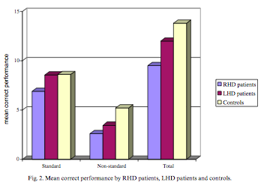

Slide 31
Right hemisphere damaged patients
stroke or tumour patients
typically intact structural linguistic abilities
odd conversational behaviour
rambling, jumping from topic to topic
problems comprehending non-literal meanings and indirect speech acts

Slide 32
Right hemisphere damage
problems using story context to answer questions, especially discourse connectives (Dipper et al 1997)
impaired comprehension of idioms, bias towards literal interpretation (Papagno et al 2006)
problems interpreting sarcastic counterfactual comments, they miss the sarcastic intent (McDonald 1999)
inability to appreciate humour – maintain coherence between the context and the critical utterance (mostly right frontal lobe lesions) (Brownell & Gardner 1983)

Slide 33
ToM and non-literal language
„By theory of mind we mean being able to infer the full range of mental states (beliefs, desires, intentions, imagination, emotions, etc.) that cause action. In brief, to be able to reflect on the contents of one’s own and other’s minds.” (Baron-Cohen 2000: 3)
to understand implicatures the hearer must establish the speaker’s communicative intention
the listener must make certain inferences about the speaker’s mental state or beliefs
second order ToM reasoning (deciding what X believes about Y’s beliefs) is strongly related to the ability to interpret non-literal meanings, to distinguish lies from jokes (Winner et al 1998)
RHD patients cannot attribute second-order intentional states (Griffin et al 2006, Happe et al 1999)
But LHD patients do not display impaired ToM performance

Slide 34
The Sally-Anne task (Baron-Cohen; Wimmer & Perner, 1983)
Typically developing:
https://www.youtube.com/watch?v=41jSdOQQpv0
Autistic:
https://www.youtube.com/watch?v=jbL34F81Rz0
Wimmer and Perner 1983

Slide 35
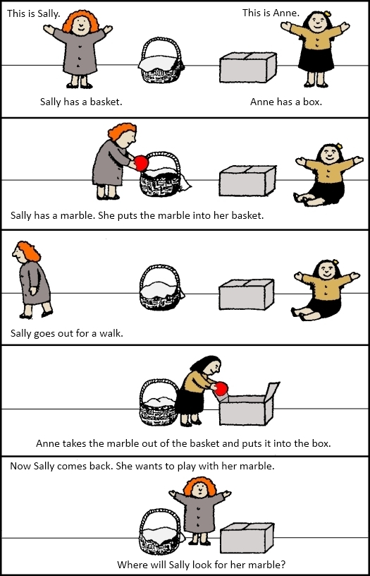
A Sally-Anne feladat

Slide 36
Griffin et al 2006
Cartoons
  physical inference: inference about prior physical events
  first-order ToM: assessment of ignorance or false belief of a character
  second-order ToM cartoons: awareness of either deception or fooling in which one character was aware of what the other character knew or did not know, and was taking advantage of this knowledge

Slide 37
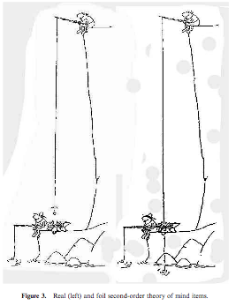
Is there anything that X doesn’t know, or is unaware of, that is important to the humour of this cartoon? If yes, what is it?
Is X trying to trick or fool Y?

Slide 38
Faux pas task
A man called Tim spills some coffee in a restaurant. He turns to a customer and, believing him to be a waiter, says ‘I’ve spilt my coffee. Would you be able to mop it up?’ (Baron-Cohen et al 1999, autistic patients)
Steve, a scientist, is traveling on a plane with his wife. Suddenly, he is tapped on the shoulder by another scientist. Steve looks up, sees that he knows this man, and says "Oh hi! How nice to run into you! Let me introduce you to my wife, Betsy. Betsy, this is Jeffrey, a good friend of mine from Harvard days," Betsy says "Oh, hi Jeffrey, pleased to meet you." The other man replies "Er, my name isn't Jeffrey, it's Mike.”
Question: Did someone in the story say something they shouldn’t have said?

Slide 39
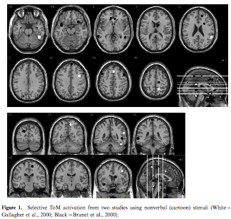

Slide 40
Not simply RHD
similar behaviour in some autistic patients
pragmatic performance may also be impaired in LHD
No clear correlation between size and place of lesion and pragmatic performance
a correlation with executive functions (working memory, attention shifting, problem solving) and sarcasm/humour appreciation

Slide 41
Theories of RHD pragmatic deficits
Inferencing hypothesis (Novak, Brownell, Gardner)
  difficulties generating inferences (e.g., Relevance Theory)
Theory of Mind hypothesis (Siegal, Happe, Stuss, McDonald)
  difficulties with forming representations of others’ mental states
  problems answering false belief questions if the question is ambiguous
  the frontal lobes may be involved in the conceptualisation of mental events – failure to recognise faux pas
Mental model hypothesis (Stemmer, Giroux)
  mental models are symbolic representations of how we perceive the world
  inference involves the manipulation of mental models to create a new one – this ability is impaired in RHD
  impairment of executive functions interferes with this process

Slide 42
Autistic Spectrum Disorder
impaired social and emotional functioning
late appearance of speech and language
some articulation problems
impaired conversational skills (e.g. turn taking)
problems with the comprehension and production of speech acts
impairment of coherence, difficulties in integrating content across narratives and discourse (Ozonoff & Miller 1996)
Difficulty with use and understanding of non-literal language

Slide 43
Primary deficit in autism
Theory of mind?
Processing deficit (weak central coherence)?
Executive functioning?

Slide 44
Autism and ToM
interpret irony or sarcasm as a simple lie (Martin & McDonald 2004)
When asked to prevent someone from something, they cannot tell a lie but can use a physical means (Sodian & Frith 1992)
are bad at detecting violations of Gricean maxims (Surian 1996)
  “How would you like your tea?” “In a cup.”
  performance is correlated with ability to attribute false beliefs
  Children with SLI performed better
use fewer anaphoric pronouns in story telling task and their anaphoric pronouns were more likely to be ambiguous - experimenter did not see the pictures (frog story) (Colle et al 2008)

Slide 45
Colle et al 2008
[The boy1 is in his2 room. He3 is watching the frog in the jar.] [His1 dog is leaning over the frog in the jar.] [The boy1 is in his2 pyjamas.]
- introduce a character
- re-introduce a character in new episode
- maintain reference

Slide 46
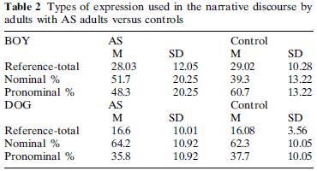
Colle et al 2008
Different use of Introduction, Re-introduction and Maintaining devices
(Definite NP, indefinite NP, pronoun)

Slide 47
ASD and local coherence
‘the ability to make contextually meaningful connections between linguistic information in short-term or working memory” (Jolliffe & Baron-Cohen 1999)
Tasks:
Read sentences with homographs
  Rare pronunciation, before context:
  The man had a second row with his wife the day after.
  Frequent pronunciation, after context:
  Everyone who wanted to see the new film had to stand in a row.
Listen to pairs of sentences: second is ambiguous but first disambiguates it
  Lexical ambiguity, rare interpretation:
  Clare was robbed as she walked along by some water. The bank was the scene of the robbery.
  Question: Where was the robbery?
  Possible responses: (1) on a river bank; (2) in a bank; (3) in the village bank

Slide 48
Weak central coherence theory (Frith 1989)
Central coherence: the ability to integrate information at different levels, e.g., extracting the gist or meaning of a story from the surface form
weak central coherence: bias to attend to parts rather than wholes
  difficulty in using context to disambiguate homographs (In Sally’s eye/dress there was a big tear)
  (Some schizophrenic patients also display this behaviour – if the primed meaning is infrequent: The guests played bridge because the river had rocks in it. (Sitnikova et al 2002))
  unusually good performance on visuospatial tasks
A cognitive style rather than an impairment (Happe et al 2001)

Slide 49
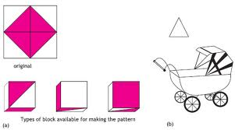
Wechsler block design, embedded figure test

Slide 50
Against coherence theory
Children with ASD tend to perform well in executive function tasks
Paranoid schizophrenia: patients can represent other minds, in fact tend to over-attribute intentions to speakers –> do not stop the inference process even when optimal relevance has been achieved (Cram & Hedley 2005)

Slide 51
Autism and executive function (Emerich et al, 2003)
Abilities mediated by the frontal cortex: planning, working memory, impulse control, mental flexibility, response inhibition)
Most experimental results are inconclusive or contradictory
Task: pick funny endings for cartoons and jokes (Emerich et al 2003)
choice of five endings:
  correct funny ending (coherent and surprising)
  straightforward ending (coherent but not surprising or funny)
  non-sequitur ending (funny and surprising but not coherent)
  and two neither coherent nor funny endings
results (not very clear!):
  autistic people significantly less likely to choose the correct funny ending
  their “wrong” answer is most likely to be the straightforward non-funny ending for cartoons and the funny non-sequitur ending for jokes
authors’ conclusion: problem is with handling both coherence and surprise at the same time (cognitive flexibility)

Slide 52
Other associations
Proverb interpretation or inferring speaker’s intentions (Brüne & Bodenstein 2005. Champagne-Lavau et al 2006, Kiang et al 2007, Corcoran 2003)
  Schizophrenic patients, RHD, ASD
  Ability to recover non-literal meaning correlated with
    ToM performance
    Verbal intelligence
    Executive functioning (context processing, cognitive flexibility)
    Inductive reasoning performance
Similar findings for traumatic brain injury patients, and Alzheimer and Parkinson’s patients

