Slide 1
Language and Thought
Using ideas from Szamarasz Vera, Bencze Ildikó, Fekete István

Slide 2
Language - Thought
the same?
one makes the other possible?
can we think without language?
does our language influence our perception of the world?
does thinking come before language or the other way round?

Slide 3
Political correctness
„language use has an effect on the way we think”
euphemisms in politics
  pacification = bombing
  increasing revenue = tax
  rationalization = lay offs
  daylight saving time = clocks go forward (nyári időszámítás)
social movements: sexist/racist etc. language is responsible for sexist/racist etc. thinking
  chairman → chairperson
  Gypsy → Roma (?)
  blind → with visual impairment

Slide 4
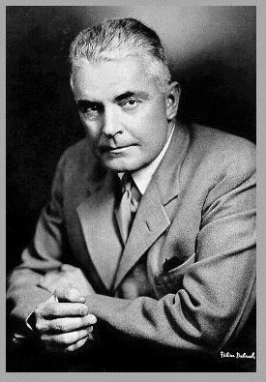
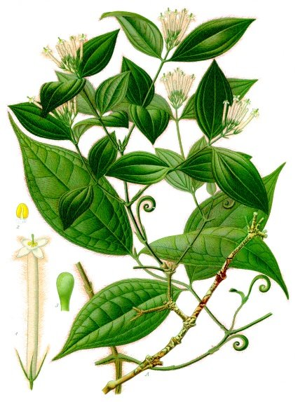
Early experiments
language = thought
Behaviorism
Watson, 1913: thought = subvocal speech
language ≠ thought
Smith et al., 1947: curare experiment: muscle relaxant
Notes:
(bármilyen racionális gondolkodás elképzelhetetlen nyelvhasználat nélkül)
(+ az egyik függ a másiktól)
curare = délamerikai bennszülöttek nyílmérge, motoros idegvégződéseket ideiglenesen megbénítja

Slide 5
Language ≠ Thought
word finding difficulties
not saying what you mean
learning and creating new words
translation between languages
animal problem solving

Slide 6
So what’s the relationship?
Piaget: cognitive development is a prerequisite to language development
Sapir & Whorf: language determines cognition
Chomsky: language and cognition are independent of each other

Slide 7
Perception of the world
Every attested encoding of categories must be within the boundaries of human cognition.
  Potawatomi (N American Indian) pronouns
  Korean spatial expressions
  Tseltal (Mexico) spatial reference
  Hungarian 3 x 3 locative system
  Fox (N American Indian) verb modes
  Hopi (N American Indian) verb tenses
  Hungarian object agreement

Slide 8
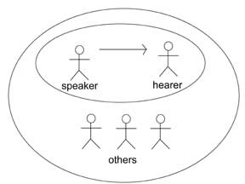
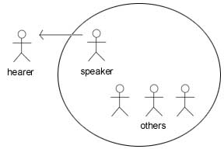
Potawatomi inclusive and exclusive pronouns: we
(www.potawatomilang.org)

Slide 9
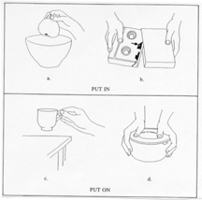
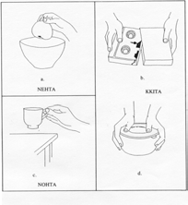
Korean locatives
(Bowerman & Choi 1994, 2001)

Slide 10
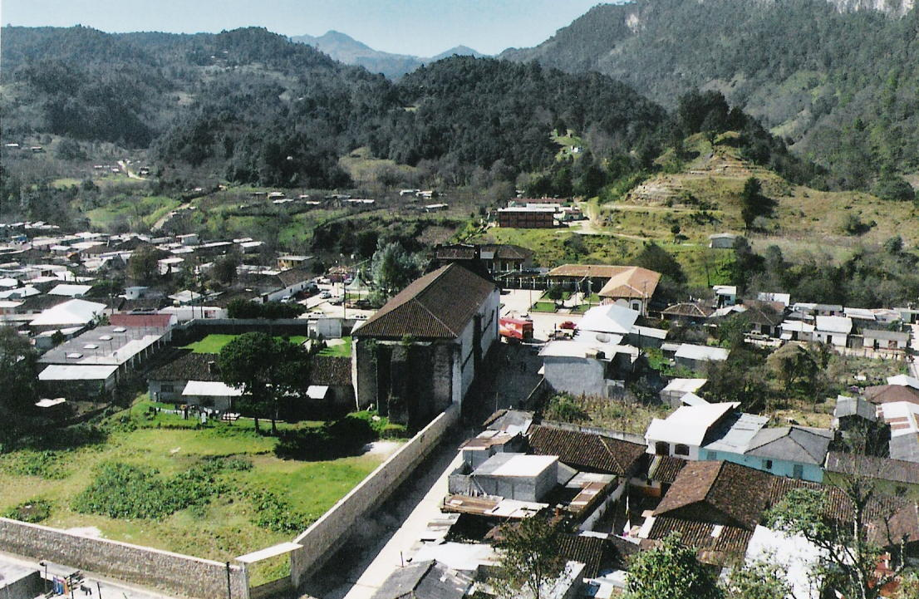
Spatial reference (Brown 2001)
Egocentric (left, right, in fron of me, behind me) – relative
Geocentric (hill-wise, sea-wise, etc) – absolute
Tseltal (Mexico):
ajk’ol „uphill”
alan „downhill”

Slide 11
Hungarian locatives
 | Static | Goal | Source
Interior (3D) | BAN | BA | BÓL
Exterior (2D) | N | RA | RÓL
Approximate (dimension neutral) | NÁL | HOZ | TÓL

Slide 12
Hopi modes (Boas 1911)
No distinction between past, present and future
Two aspects:
  Facts directly experienced by the speaker
  Facts/ideas known from hearsay, guessing or inferred

Slide 13
Fox tenses (Dahlstrom 1997)
pi’w „he comes/came”
pi’wen „he is believed to come”
piasah „he’s coming after all”
piapah „he’s not coming after all”

Slide 14
Hungarian object agreement
The verb form signals the specificity of the object
  Megevett egy almát.
  he.ate.something an apple
  Megette az almát.
  he.ate.it the apple

Slide 15
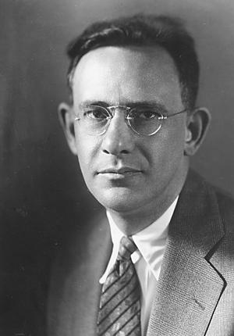
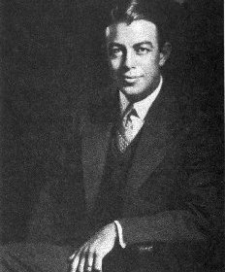
Edward Sapir
(1884-1939)
US anthropologist
Benjamin Whorf
(1897-1941)
US linguist

Slide 16
The Sapir-Whorf Hypothesis
Linguistic determinism
Strong version: thought is determined by language
Weak version: thought is influenced by language
In literature
Orwell: 1984 – Newspeak
Linguistic relativity
“The diversity of languages is not a diversity of signs and sounds but a diversity of views of the world.”
Notes:
Linguistic Determinism refers to the idea that the language we use to some extent determines the way in which we view and think about the world around us. The concept has generally been divided into two separate groups - 'strong' determinism and 'weak' determinism.

Slide 17
Linguistic relativity: examples
colour terms
grammatical gender
spatial language

Slide 18
Basic colour terms
(Berlin & Kay, 1969)
Definition
  1 morpheme
  not restricted to a subclass of objects (pl. blonde)
  do not overlap with other colour terms (pl. turquoise)
  frequent and in general use
Berling & Kay identified 11 basic colour terms: black, white, red, yellow, green, blue, brown, pink, purple, orange, grey.

Slide 19
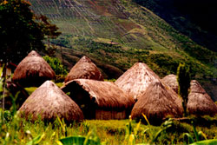
There are differences between languages in the number of basic colour terms used:
2 (Dani, New Guinea) - 11
Bantu languages: ‘grue’ (blue + green)
Russian: goluboy (light blue), siniy (dark blue)
But: There seems to be a universal hierarchy of colour categorisation.

Slide 20
black
white
red
green
yellow
blue
brown
purple
pink
orange
grey

Slide 21
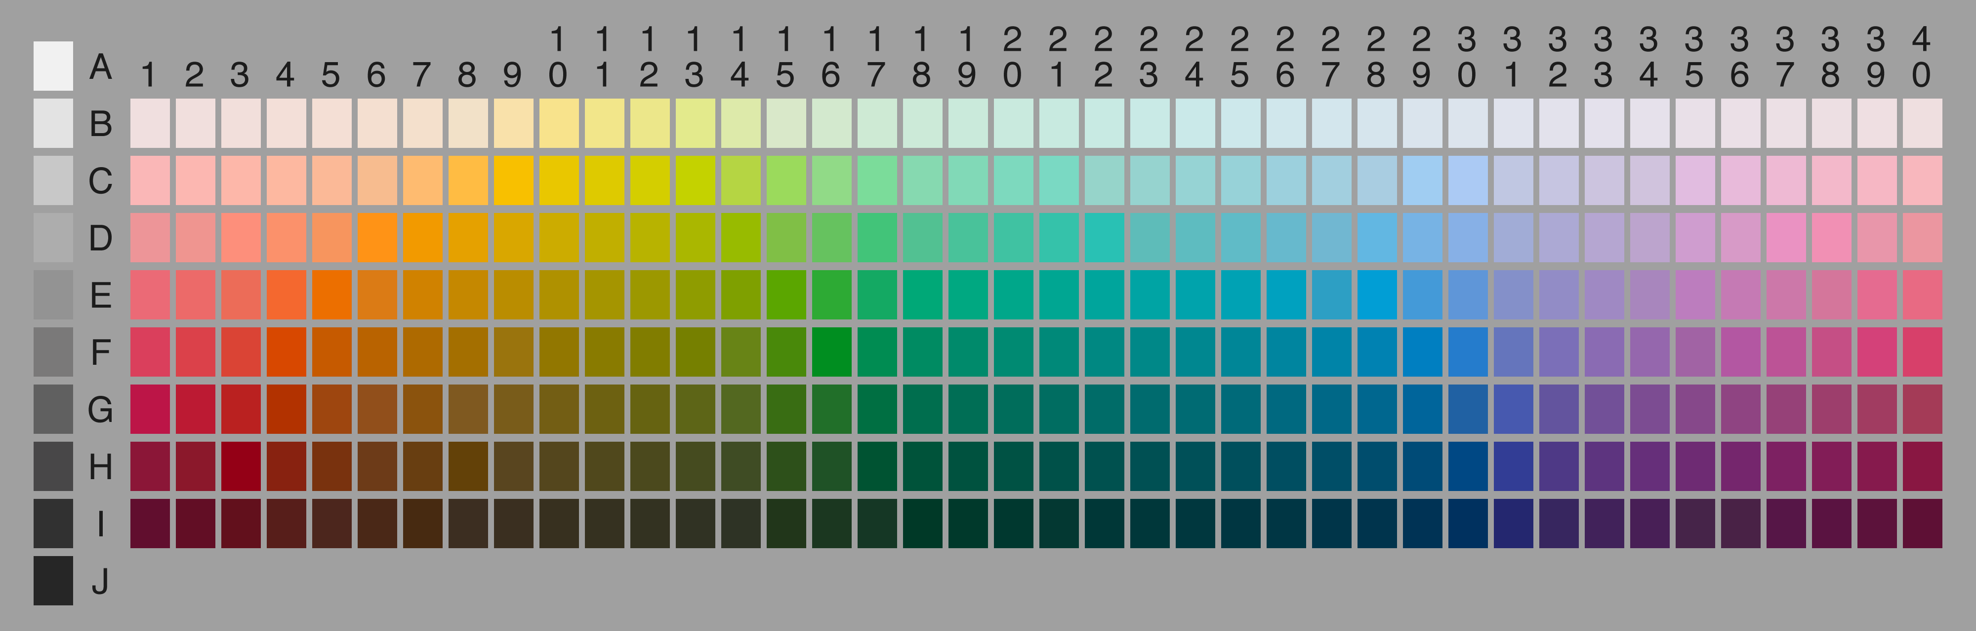
Berlin & Kay’s experiments conclusion: colour perception is not influenced by language
Munsell colour chart: saturation, brightness and shade
Participants asked to pick the best exemplar
The same are chosen independently of language (best ‘grue’ is the same as best green

Slide 22
More experimental evidence against relativity
(pl. Heider & Oliver, 1972; Rosch, 1978)
Dani people’s performance at distinguishing and recalling colours is as good as English speakers’
Both Dani and English speakers are better at remembering focal colours (Berlin & Kay’s best exemplars)

Slide 23
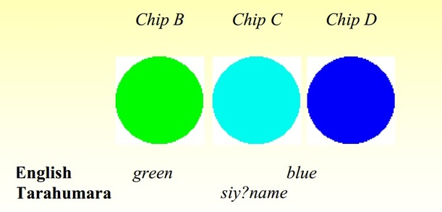
Experimental evidence for relativity
(Kay & Kempson 1984)
Participants: English speakers and
Tarahumara (Mexico) speakers (‘grue’ language)
Task: choose the chip that’s different
Results:
English speakers
chose chip with different
colour name
Tarahumara speakers
had no preference

Slide 24
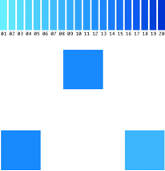
Experimental evidence for relativity
(Winnawer et al 2007)
Participants: English speakers and
Russian speakers (two blues)
Task: choose the chip of the two at the bottom that’s the same as the one on top
Distractor task: verbal numerical vs. non-verbal spatial task
Results: Reaction time
Russian speakers
were faster when the two chips were from
different linguistic categories
But only with spatial distractor!
English speakers’ RTs were only influenced
by the distance between the shades

Slide 25
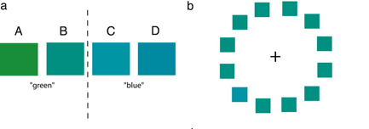
Left vs. Right Visual Field
(Gilbert et al 2006)
Conditions: Single different chip in left vs. right visual field
Task: Where is the different chip: left or right?
Results: Reaction time
Faster response for RVF than LVF when the target chip was from another linguistic category
But not when it was from the same linguistic category

Slide 26
Grammatical gender

Slide 27
Is grammatical gender arbitrary?
Experiment (Boroditsky & Schmidt, 2003)
  English speakers assign genders to objects and animals
  Compared to: object genders in Spanish and German
  Hypothesis: if grammatical gender is arbitrary, there’ll be no agreement
  Results
  Animals: significant agreement
  Objects: chance agreement

Slide 28
Does grammatical gender influence our attitudes towards objects?
Experiment (Boroditsky & Schmidt, 2003)
  Spanish, German and English speakers (language of experiment is English)
  English speakers assign gender to objects
  learning: 24 pairs of object + male/female name
  test: object prompt – recall name
  Results
  In Spanish and German speakers, better recall of names matching the grammatical gender of the object in their language
  In English speakers, better recall of names matching the gender assigned to the object
    apple – Paul / Paula
    bench – Eric / Erica
    clock – Karl / Karla
    apple – ?
    bench – ?
    clock – ?

Slide 29
Exotic genders
Dyribal (Australia)
  bayi: men, kangaroos, bats, snakes, fish, the moon, rainbow, storm, boomerang…
  balan: women, water, fire, duck billed platypus, dog, bird, scorpion, starts…
  balam: edible fruits, plants, honey, cigarettes, wine, cake…
  bela: body part, meat, bee, wind, tree, grass, rock, language, noise…
  Lakoff, Women, Fire and Dangerous Things (1987)

Slide 30
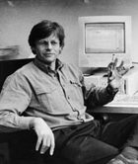
Spatial reference
Locating objects in space
Levinson: 3 reference frames in languages :
  Relative
  Intrinsic
  Absolute

Slide 31
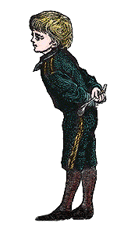
Relative
right
back
front
left
Notes:
Relative frame of reference – some objects do not have an intrinsic “front” or “back” , e.g. balls, lamp posts, and trees.
When using a relative frame of reference, front/back is assigned to object based on its relation to a viewer’s
perspective. In English, this is done as if the object is facing you… But in other languages, e.g. the opposite may be the case.
And how the sides are labelled is also variable… Might just be “sides” and in English, left right is relative to viewer, not object.
Provides consistent logical inferences, unlike intrinsic system…

Slide 32
2. Intrinsic
back
right
left
front
Notes:
For intrinsic, the different axes are determined with respect to inherent features of a person or object – For people, this correlates with parts of the body – particularly the face and front of the body vs. the back.
So, I have a front and a back, and I can talk about objects being in front of me or behind me.
This correlates too with perceptual asymmetry -- the front is usually more known and accessible, whereas the back is less so.
For objects, intrinsic front/back may be determined by things like canonical direction of motion (e.g.cars) and interaction (e.g. TVs, computers, buildings). E.g. He sat in front of the TV for hours, The car is rolling backward.
---The right/left or side axis could be defined as perpendicular to the front/back axis. It lacks the asymmetries of the front/back axis, and in fact some languages, such as ?? do not distinguish between left and right
Because these terms are usually used in relation to a canonical upright orientation of the human body, they correspond with the horizontal axes. -- it is a subject of research as to how people use these orientations when they are, for example, laying down….
And there are cross-linguistic differences as well….
----Some languages, such as ???? use other types of figures, e.g.animal bodies in which case front (belly) will generally correspond with down, and back with up. (and orientation of figure doesn’t have to be canonical one)

Slide 33
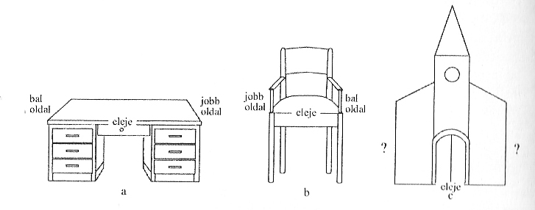

Slide 34
3. Absolute
North
West
East
South
Notes:
An absolute system doesn’t involve viewpoint or the inherent characteristics of the LM. Instead, they use the orientation of the landscape/”ground”…
This may involve local geographic landmarks, such as mountains and shorelines. But it can also be fairly abstract, as in north east south west type systems which don’t change as one moves around in the landscape.
[e.g. Tenejapan Tzeltal]
For these systems, the description of a spatial array stays constant even as viewpoint changes (e.g. cup to the north of the plate).
Like relative, preserves logical inference…

Slide 35
Where is the fork?
Relative: To the left of the spoon.
Intrinsic: At the head of the spoon.
Absolute: To the East of the spoon.

Slide 36
Reference frames in different languages
Absolute
Guugu yimithirr (Australia)
Arrente (Australia)
Tzeltál (Mexikó)
Longgu (Solomon Islands)
Belhare (Nepal)
Bali (Indonesia)
Relative
English
Dutch
Japanese
Yucatek (Mexikó)
Hungarian

Slide 37
Does this variation affect thinking?

Slide 38
Tzeltal
No spatial expressions ‘left’ or ‘right’
Body parts: left ‘xin’ right: ‘wa’el’
Absolute reference frame:
  „alan”: downhill ~North
  „ajk’ol”: uphill ~South
  used indoors and outdoors

Slide 39
Experiments
Non-linguistic spatial rotation tasks
  Dutch (relative) + Tzeltal (absolute)
  180 degree rotation: relative vs. absolute reference frames behave differently:
      relative: switch
      absolute: no switch

Slide 40
1. Chips task

Slide 41
Chips task - results

Slide 42
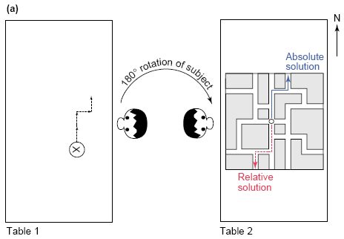
Labyrinth task

Slide 43
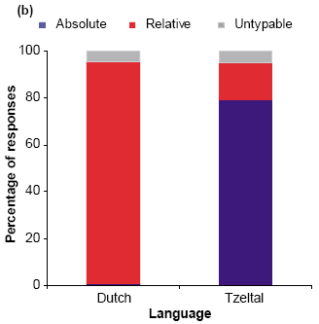
Labyrinth - results

Slide 44
Ecological explanation
Choice of reference frame may depend on
  environment: (city– country/open terrain-dense forest)
  culture: individualism vs. collectivism
Li & Gleitman (2002)
  experiments transferred to a dark room
  English speakers switched to absolute reference frame
  The fewer reference points there are, the more difficult it is to use an intrinsic frame

Slide 45
Reference frames and ecological factors

Slide 46
PC again
new gender-neutral version of the bible (1995):
Our Father-Mother in Heaven…
BBC 2005, in connection with Guatanamo: terrorist => misguided criminal
British Teachers’ Association:
failure (at exams) => deferred success
(rejected by the Minister for Education)

