Slide 1
Metaphor theory

Slide 2
Truth-conditional semantics and the correspondence theory of truth
The world consists of a set of state of affairs.
Alfred Tarski (Polish-American mathematician, 20th c.): an utterance is true if it corresponds to a state of affairs.
  “The snow is white” is true if and only if snow is white.
The meaning of a sentence:
  the set of all states of affairs for which the proposition conveyed by the sentence is true.

Slide 3
We know the meaning of a sentence if we can tell under what conditions the proposition conveyed by it is true (i.e. if we know its truth conditions)

Slide 4
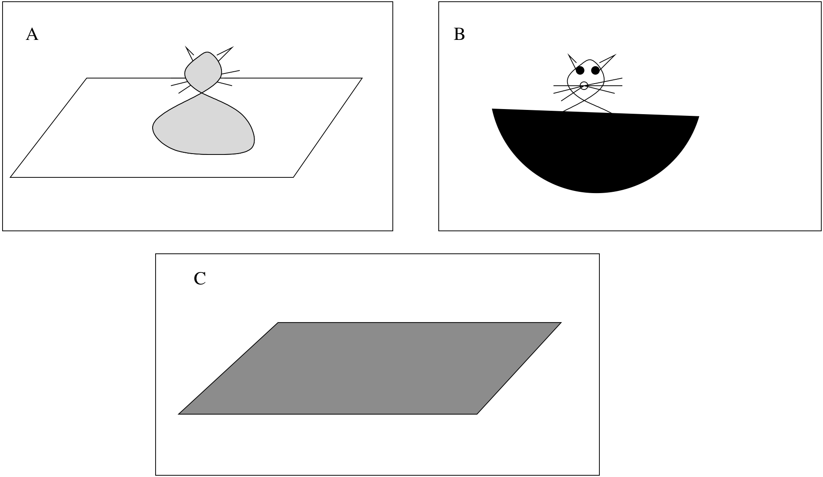
The cat is on the mat.

Slide 5
Non-literal meaning
Indirect speech (speech acts)
Irony, sarcasm
Metaphor

Slide 6
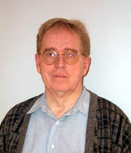
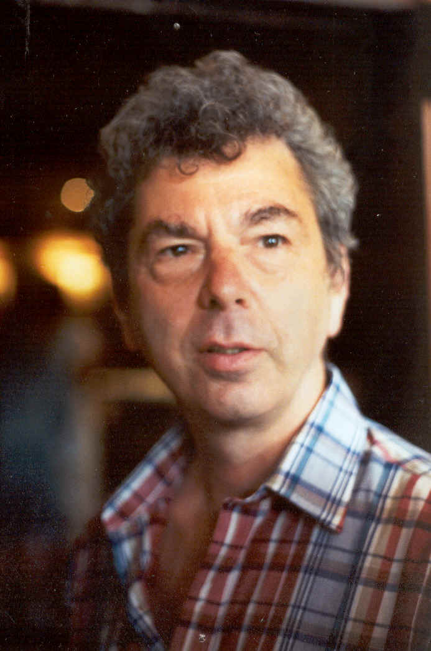

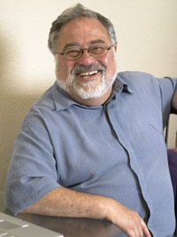

Ronald Langacker
Charles Fillmore
Leonard Talmy
George Lakoff
Mark Johnson

Slide 7
Metaphor versus Relevance
Relevance: a pragmatic theory complementing semantics
  traditional formal linguistic theory
  syntax– semantics- pragmatics
Metaphor theory: a completely new approach to language
  cognitive linguistics
  semantics and pragmatics are not separated
  syntactic phenomena are also explained by semantic-pragmatic principles

Slide 8
Classic literature
George Lakoff & Mark Johnson, Metaphors we live by. Chicago: University of Chicago Press. 1980.
George Lakoff, Women, Fire and Dangerous Things. Chicago: University of Chicago Press. 1987.
Textbook: Vyvyan Evans & Melanie Green, Cognitive Linguistics: An Introduction. Edinburgh: Edinburgh University Press. 2006.
(Google Books, Embodiment and Conceptual Structure, Metaphor and Metonymy)

Slide 9
The motivation for Metaphor Theory:
  problems with Tarski’s correspondence theory of truth
  contraditions between formal logic and human thinking

Slide 10
Truth or Lie
John and Mary recently got together. Valentino is Mary’s previous boyfriend. Valentino has been sick for two weeks but he met Mary last night.
  John: Have you met Valentino this week?
  Mary: Valentino’s been sick for two weeks.
  Did Mary lie?
  Coleman & Kay 1981

Slide 11
What does it mean to lie?
  Coleman & Kay (1981):
    the speaker doesn’t believe what he or she is saying
    the speaker intends to deceive the listener
    the statement probably doesn’t correspond to the state of affairs
  Subjects’ spontaneous answer:
    a lie is a statement that does not correspond to the state of affairs

Slide 12
Lakoff’s explanation for the contradictory results of the “lie” experiments:
  Coleman & Kay’s truth:
    refers to states of affairs
    objective
    independent of people’s mental processes
  Everyday truth concept:
    refers to sincerity of intentions (deception = lie)
    interpreted in terms of people’s mental representation of the world

Slide 13
Lakoff: Idealised Cognitive Model (ICM) resolution of the contradition
ICM: a mental model of schemas observed in the world – theory of the organisation of human knowledge
Categories used in everyday communication are defined by ICMs; they do not necessarily correspond to scientific categories:
 | biological category | common category
cucumber | fruit | vegetable
carrot | root | vegetable
nut | fruit | nut
oregano | leaf | herb

Slide 14
scientific categories describe reality
mental models describe an “idealised” image (corresponding to people’s ideas)

Slide 15
Basic ICMs
basic level: preconceptual, image schemas of concepts having directly perceptible meaning
  bodily experiences:
  hunger, pain, water, wood, stone, life forms, everyday objects
  spatial schemas:
  source-path-goal, centre-periphery, container, whole-part, up-down, linearity, etc.

Slide 16
On image schemas
Memory traces of perceptual states
They follow from natural physical properties:
  people walk upright, their body is vertically asymmetrical: up-down schema.
They develop through experience (not innate)
They are schematic, not detailed

Slide 17
they allow people to structure the world:
  container schema: categorisation
  up-down and part-whole schemas: hierarchical organisation of categories
abstract knowledge is interpreted based on these schemas
conceptual structure, theory of embodiment

Slide 18
bodily, perceptual, motor experiences
conceptual structure
semantic structure

Slide 19
Propositional ICMs
Second level
  based on Fillmore’s mental models and frames
  complex knowledge composed of basic schemas
  mental models of situations in life
    restaurant, shopping, travelling, etc

Slide 20
McDonald’s restaurant:
  I’ll have a hamburger with mustard and ketchup but no onions please. The meat should be a bit on the rare side.
  I’ll have a hamburger, warmed, packed in a paper box, with a napkin. It should be about 15 cm across and please either hand it to me over the counter or put it on the tray.
  Searle (1979)

Slide 21
During World War I Ronald Reagan’s birth mother dropped his analog watch into the sound hole of his acoustic guitar.
  uttered in 1919
  uttered in 1984
  Fillmore (1985)

Slide 22
Metaphor ICMs
more abstract level: representation of concepts that cannot be directly experienced – in terms of basic ICMs
  the source domain structures the target domain
  source domain: concrete experiential schema
  target domain: abstract concept

Slide 23
Metaphors based on spatial schema
Time,
Relatedness,
Status,
Mathematics,
Emotions
Quantity
Space
mappings
Source domain
(concrete)
Target domain
(abstract)

Slide 24
Space as a source domain
Abstract concept | Example
Time | on Tuesday, between 6 and 7
Relatedness | distant relative, close friend
Social status | high position, low status
Mathematics | bounded function, closed set
Emotions | you look downhearted, in high spirits
Quantity | high income

Slide 25
Event structure metaphor: relationship – journey
This relationship is a dead end.
Their marriage is on the rocks.
They have come a long way since the first kiss.
They went their separate paths.
Their relationship is on track.

Slide 26
Linking the participants
Source domain JOURNEY | Target domain RELATIONSHIP
the journey | events in the relationship
the traveller | the lovers
obstacles | difficulties
path | progress in time
means of transport | nature of progress

Slide 27
Conceptual metaphors
everyday language use
The use of concrete experiential concepts to describe more abstract phenomena
Conceptual mapping between the actors of the source and the target domains
Mapping is unidirectional
A metaphorical statement may be false in its literal sense (you are a pig)
According to the theory, not only language but all human cognition relies on metaphors – conceptual
We cannot think in other terms!

Slide 28
Categories of metaphor
  Conventional
    His head wanted to explode.
    Everything is in good hands.
    You have to conquer your feelings.
  Novel
    My car is thirsty.
    My mother-in-law is a lion.

Slide 29
Similar metaphors tend to be conventionalised in different languages
  Cognitively salient source and target domain pairs
  Based on experiences
    MORE IS UP, LOVE IS A JOURNEY, THEORIES ARE BUILDINGS, etc.

Slide 30
Questions: what differentiates metaphors from non-metaphors
Literal versus non-literal meaning?
Truth conditional versus non-truth conditional?
Context-independent vs. context-dependent?

Slide 31
Two approaches to metaphor identification
Statistical analysis (Latent Semantic Analysis)
Statistical patterns in linguistic context
Psycholinguistic approach
Metaphor vs. ambiguity or vagueness

Slide 32
Statistical approach
Basic assumption:
Metaphorical processing is defined as
  Conceptual mapping from a source domain to a target domain
  An expression is metaphorical if the two domains can be shown to be distinct

Slide 33
The statistical approach
(Kintsch 1999, 2000, Goatly 2002)
Semantic distance between domains
There are degrees of metaphoricity
  Strong metaphors are those where the distance between the domains is relatively great
  (My lawyer is a shark)

Slide 34
The statistical approach
The distance between domains is measured through the distributional distance between the words representing the domains
(eg. lawyer and shark)
  Distributional distance: informally, the likelihood and size of the overlap between the sets of words occurring in the two domains

Slide 35
LAWYER SHARK
office
law courts fish
solicitor fee vicious predator sea
justice rich greedy huge fins
clever boat teeth

Slide 36
COFFEE TEA
drink leaves
beans stimulant lemon
cream milk hot cup
breakfast

Slide 37
Details of Latent Semantic Analysis
the meaning of a word is represented as a vector in a high-dimensional semantic space
co-occurrence matrix constructed from corpus
the 300 most important dimensions are selected: these define the semantic space of the word, give its vector
vector similarities are computed (cosine between vectors)
closest semantic neighbour of unit: the unit with the most similar vector

Slide 38
Comparing metaphors to literal paraphrases
Kintsch’s Construction integration model calculates meaning vectors for propositions
  Differentiates predicates from arguments
  Her heart is a closet. ≠ Her closet is a heart.
  Allows the vector comparison of sentences with landmarks:
  This job is a jail vs restrictive
  vs small windows

Slide 39
Consequences of the statistical model
There are degrees of metaphoricity
Metaphor is an instance of polysemy
  The two meanings of a polysemous word like bank are differentiated in exactly the same way

Slide 40
Psycholinguistic studies
(Inhoff 1984, Kemper 1989; Blasko & Connine 1993; Keysar 1989; Wolf & Gentner 2000; Glucksberg et al 1984; Glucksberg 2003)
A number of studies show that metaphorical processing is not qualitatively different from literal processing
Metaphors could indeed be instances of polysemy

Slide 41
Literal meaning does not have priority over metaphorical meaning in processing
  Figurative interpretations do not take longer to process
Metaphor comprehension is not optional
  Metaphors (Some jobs are jails)
  take longer to reject than
  literally false statements (Some apples are tables) when subjects are instructed to judge literal truth.

Slide 42
Metaphors are generally understood directly as categorical assertions
  Similes (Some ideas are like diamonds)
  are interpreted slightly differently from
  metaphors (Some ideas are diamonds)
    similes evoke vehicle-biased properties (rare, valuable),
    metaphors evoke topic-biased properties (insightful, creative)

Slide 43
Literal meaning interferes with metaphorical processing just as one sense of a polysemous word interferes with the processing of its other sense
  A literal vehicle prime like Sharks can swim increases the processing time of the metaphor My lawyer is a shark relative to
    Neutral controls
    (Some tables are made of wood)
    Topic-property sentences
    (Some lawyers are married)

Slide 44
Corpus study of the context effects of metaphors (Martin 2006)
To what extent does the context predict the occurrence of a metaphor?
Identified financial metaphors in a corpus
(The inflation rate fell)
Annotated four context sentences for each metaphorical test sentence for
  Literal occurrence of vehicle or its neighbours
  (fall, sink, etc)
  Literal occurrence of topic or its neighbours (inflation rate, price, etc)
  Occurrence of metaphor with the same basic structure as the test metaphor (Prices dropped).

Slide 45
Results of corpus analysis
Relative to the baseline of metaphor likelihood in the text
  Metaphor is less likely to occur if preceding context contains literal use of vehicle
  Metaphor is more likely to occur if preceding context contains
    Literal use of topic
    And especially metaphors with the same basic structure

Slide 46
Consequences of corpus study
Confirms statistical approach
Confirms psycholinguistic findings of inhibition/priming

Slide 47
Can the comprehension of abstract language be rooted in sensory experience?

Slide 48
Abstract - Concrete - Metaphorical
Her friends persuaded the girl to come to the party.
The bulldozer pushed the pile of dirt across the lot.
Her friends pushed the girl to agree to an interview.

Slide 49
Explanations
Situation semantics (simulation)
Conceptual metaphor theory (image schemas)
Statistical learning theory (linguistic analogy)

Slide 50

Perceptual vs. amodal symbols
Perceptual (Barsalou 1999) | Amodal (Fodor & Pylyshyn 1988)
Representational system directly related to perceptual states | Representational system abstracted away from perceptual states
Perceptual symbols reside in sensory-motor systems | Symbolic thought analogous to language
The cognitive system constructs simulations of absent events | The cognitive system extracts statistical patterns
Embodiment: a symbol’s meaning reflects the physical system where it’s represented | Disembodied symbols: can be implemented in other physical systems such as computers

Slide 51
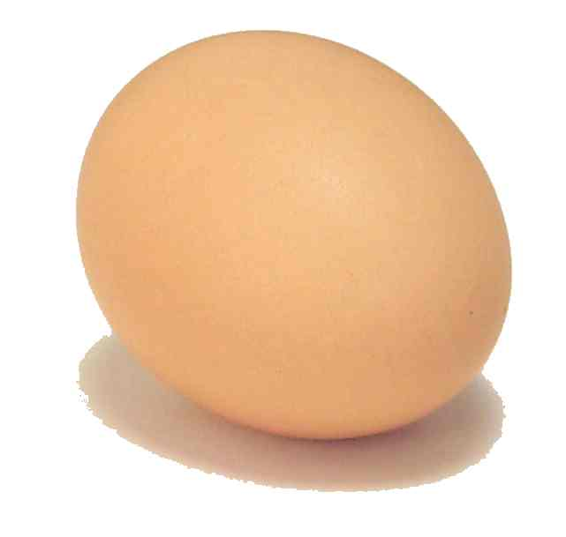
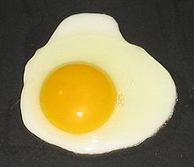
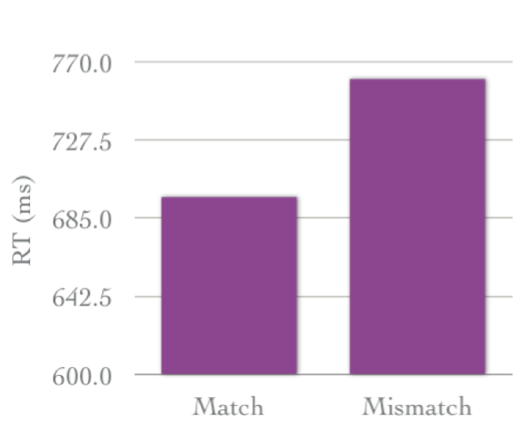
Situation models
Is the picture related to the sentence (sequential screen presentation)?
There’s an egg in the fridge.
There’s an egg in the pan.
Zwaan et al 2002

Slide 52
Fictive motion
Story:
Imagine a desert, 400 miles in diameter. There is a road in the desert. It is called Road 49. Today Maria is driving to her aunt’s house. She’s driving on Road 49. It takes her over 7 hours.
Target sentence (Does it relate to the story?):
Road 49 crosses the desert.

Slide 53
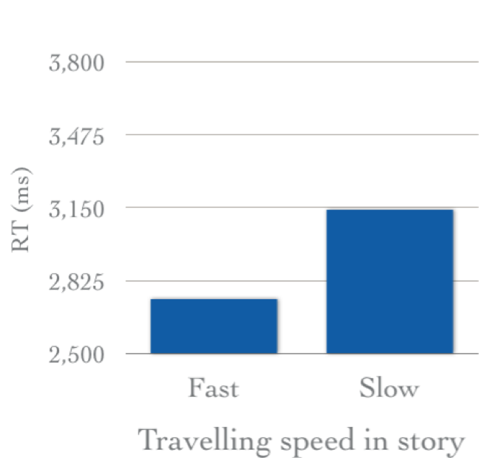
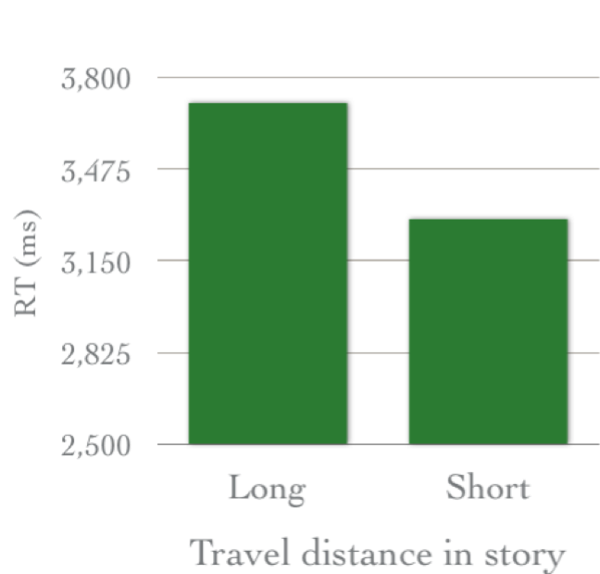
Matlock, Fictive Motion as Cognitive Simulation. Memory and Cognition 2004.

Slide 54
Perceptual symbols and abstract concepts
Conceptual metaphor theory (Lakoff & Johnson 1980)
  metaphors mediate (LOVE is WAR)
Direct perceptual representation (Barsalou 1999)
  identify an event sequence that frames the concept
  simulate the mental (introspective) states shared by that sequence

Slide 55
Action compatibility effect
Sensibility judgements of statements implying motion
  Courtney handed you the notebook.
  Liz told you the story.
  You handed courtney the notebook.
  You told Liz the story.
Simultaneous action (position of response button)
  Toward the body
  Away from the body

Slide 56
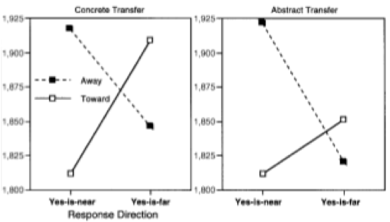
Glenberg & Kaschak, Grounding Language in Action. Psychonomic Bulleting & Review. 2002

Slide 57
Motion in time
Answer the question:
Next Wednesday’s meeting has been moved forward two days. What day is the meeting now that it has been rescheduled?
People who have just got off a plane are more likely to say “Friday” than people waiting around at an airport.
(Boroditsky & Ramscar 2002)

Slide 58
Fictive motion in time
Read and draw
  FM sentence
  The bike path runs alongside the creek.
  Non-FM sentence:
  The bike path is next to the creek.
Answer the question:
Next Wednesday’s meeting has been moved forward two days. What day is the meeting now that it has been rescheduled?

Slide 59
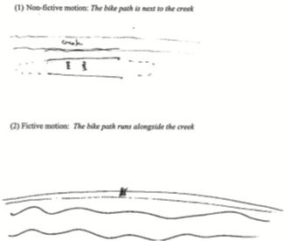
Matlock, Ramscar, Boroditsky,On the experiential link between spatial and temporal language. Cognitive Science 2005

Slide 60
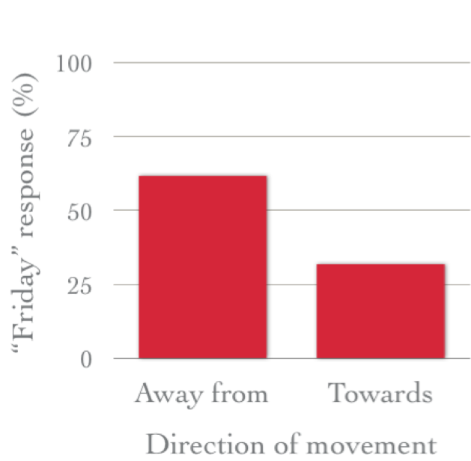
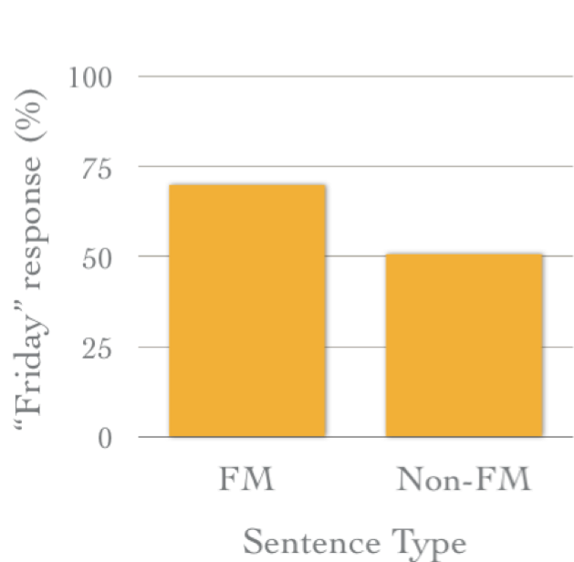
The road comes from NY.
The road goes to NY.
runs along vs. is next to

Slide 61
Compatibility vs. Interference effects
Understanding an utterance involves the activation of perceptual and motor representations.
  it should prime these representations
Mental simulation engages certain neural structures
  If the same neural structures are engaged by the task, there’ll be interference

Slide 62
Bergen et al 2007
The mule climbed.
The rates climbed.
The rates increased.
(auditory)
Circle or square?

Slide 63
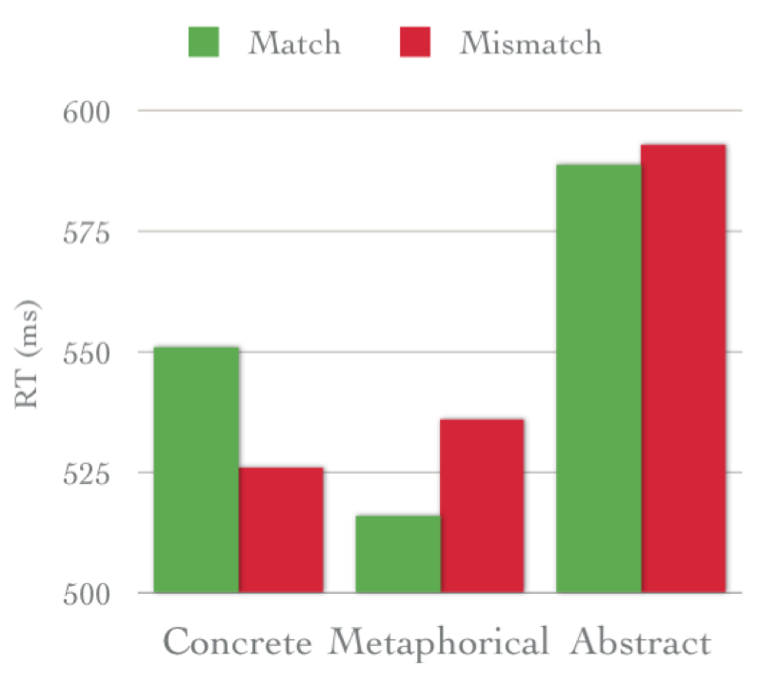
Metaphorical and abstract not significant

Slide 64
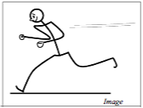
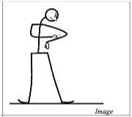
Does the verb match the image?
Matching verb | run | scratch
Non-matching same effector | kick | hold
Non-matching different effector | drink | stumble
Bergen, Narayan, Feldman, Embodied Verbal Semantics: Evidence from an Image-Verb matching task. Proceedings of Cognitive Science. 2003.

Slide 65
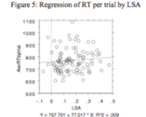
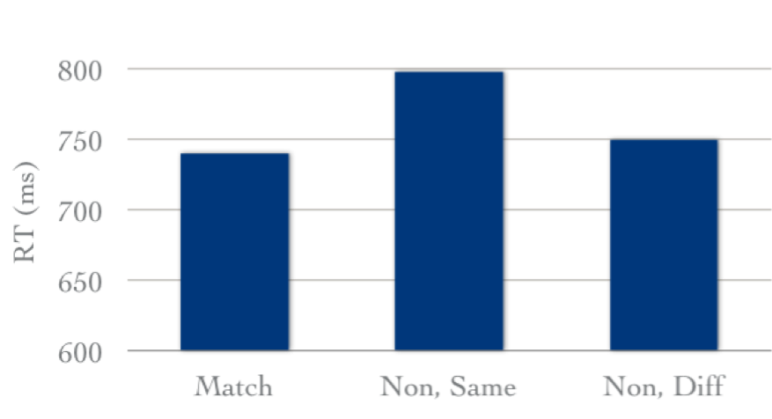
Interference caused by semantic similarity?
LSA: significant but weak correlation

Slide 66
Simulation vs. Semantic closeness
Iconic
Close -Distant
Reverse-iconic
Close - Distant
Control
Close - Distant
attic
attic
basement
web
basement
attic
spider
Louwerse & Jeuniaux 2008, How fundamental is embodiment to language comprehension? Constraints on embodied cognition.

Slide 67
Semantic similarity judgement task
  reverse-iconic pairs had marginally longer RTs than iconic pairs
  semantically close pairs had shorter RTs than semantically distant pairs
Lexical decision task
  no difference between iconic and reverse-iconic order
  shorter RTs for semantically close pairs than for semantically distant pairs

Slide 68
Modality
Rapid Serial Visual Presentation or auditory presentation, sensibility judgement
The commuter had just arrived on the platform when the train roared into the station.
Auditory stimuli conveying motion toward, away, upward or downward relative to listener

Slide 69
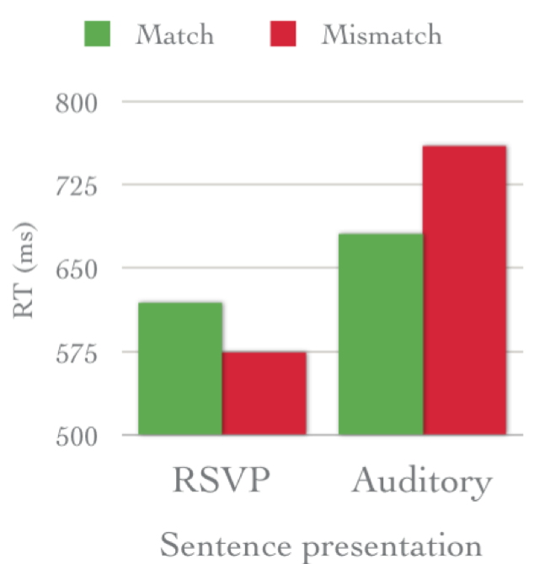
Different modalities: competition for resources
Same modalities: attentional system filters out secondary stimulus
Kaschak, Zwaan, Aveyard, Yaxley, Perception of Auditory Motion Affects Language Processing. Cognitive Science. 2006.

